Slide 1
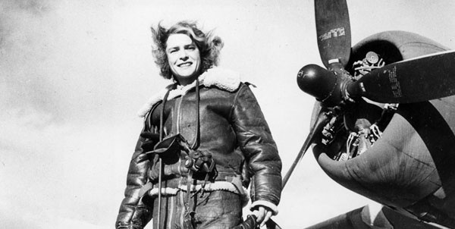
Margaret Bourke-White
(1904-1971)
Self-Portrait, 1943, Margaret Bourke-White

Slide 2
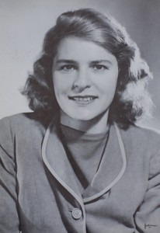
Early Life
June 14, 1904 (The Bronx)
Joseph White (inventor and engineer) and Minnie Bourke – both fairly progressive and ethical
Grew up in Bound Brook, NJ
Homeschooled, one of three
Her father became interested in photography

Slide 3
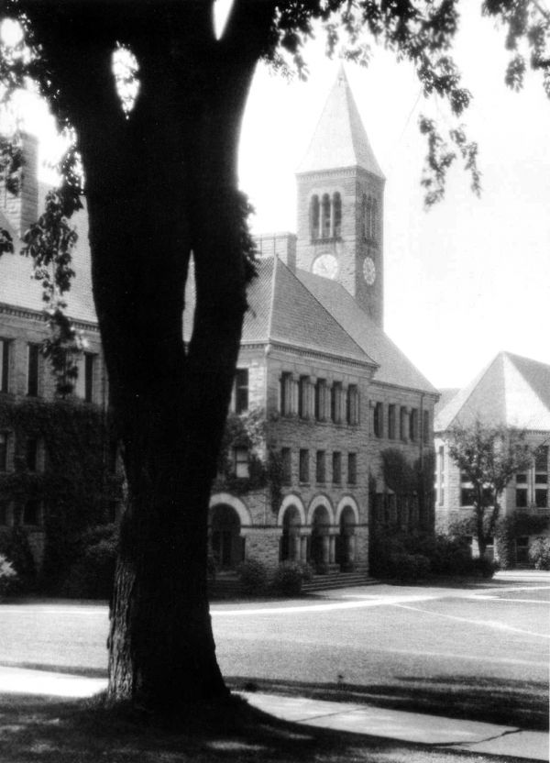
Adult Life + Beginnings as Photographer
Began college at Columbia University in 1921
Dad’s death in 1922
Transferred to the University of Michigan to study herpetology
Married Everett “Chappie” Chapman in 1924, divorced two years later
Transferred to Purdue, then Western Reserve and then Cornell for paleontology
Gave up on paleontology and started making money taking and selling photos of Cornell, then moved from there to New York and then Cleveland
“Law College,” 1926, Margaret Bourke-White

Slide 4
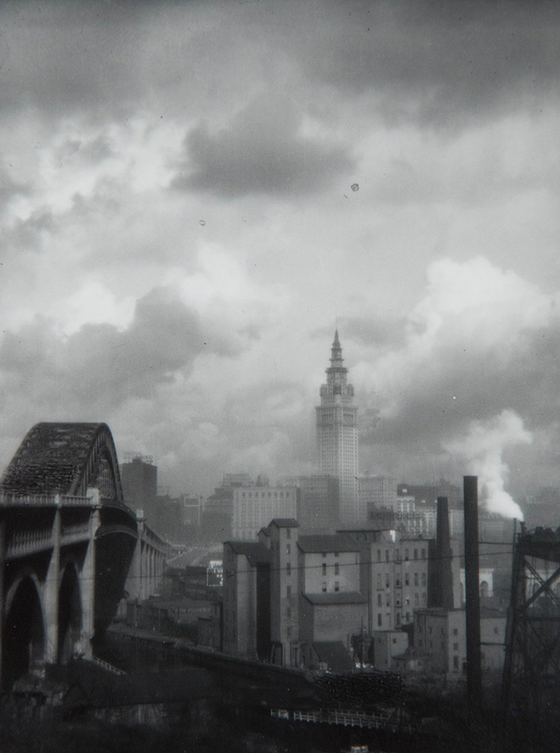
Photographic Career
Breaking gender roles
Manufacturing of printing press
Architecture
Terminal Tower
Otis Steel Company
Terminal Tower with Bridge, 1928, Margaret Bourke-White

Slide 5
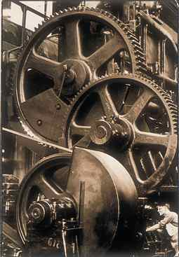
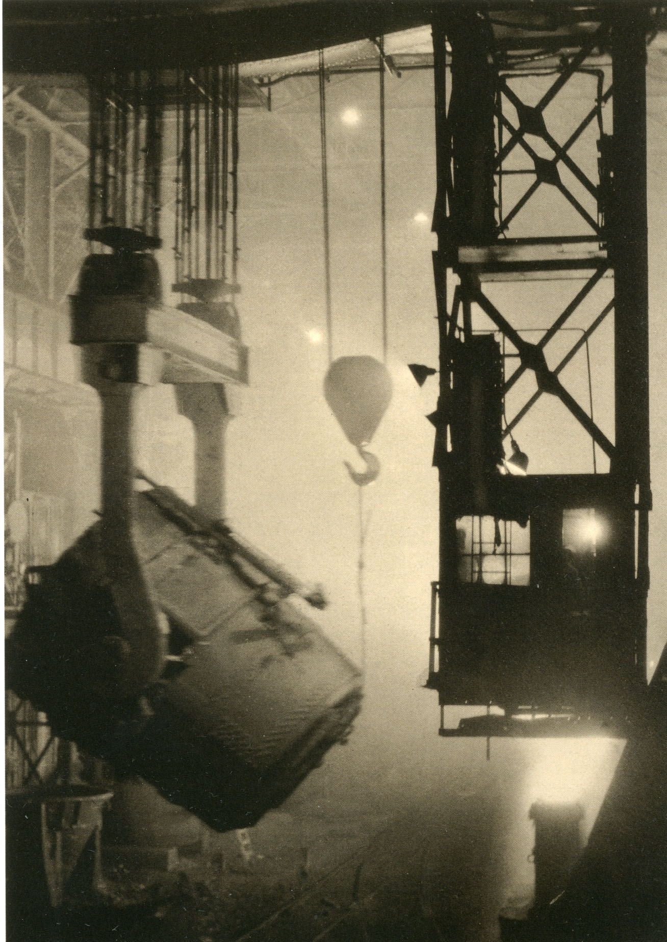
Chrysler: Gears, 1929, Margaret Bourke-White
Otis Steel, 1928, Margaret Bourke-White

Slide 6
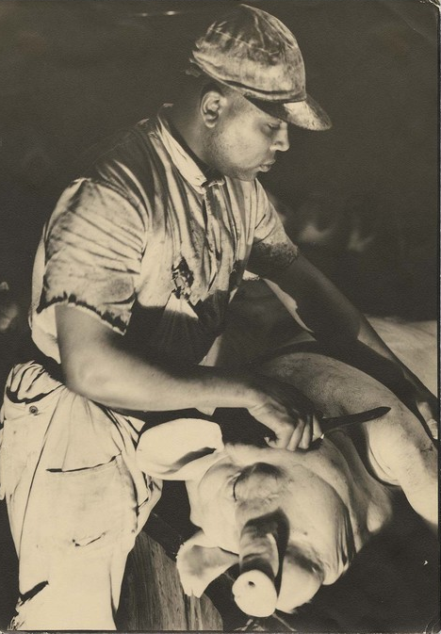
Photojournalism
Henry Luce brought her to Fortune
Popularized photo-essay, “Hogs”
Germany and Soviet Union
The New York Times Sunday Magazine, Soviet magazines
Moved to LIFE, first cover image and first female staff photographer
Industry → social change
First female war correspondent
Army Air Corps
Met and married Erskine Caldwell, 1939 – 1942
India
Helicopter accident
Knife-wielding butcher about to cut up dead pig at Swift meat packing Packington Plant, 1929, Margaret Bourke-White

Slide 7
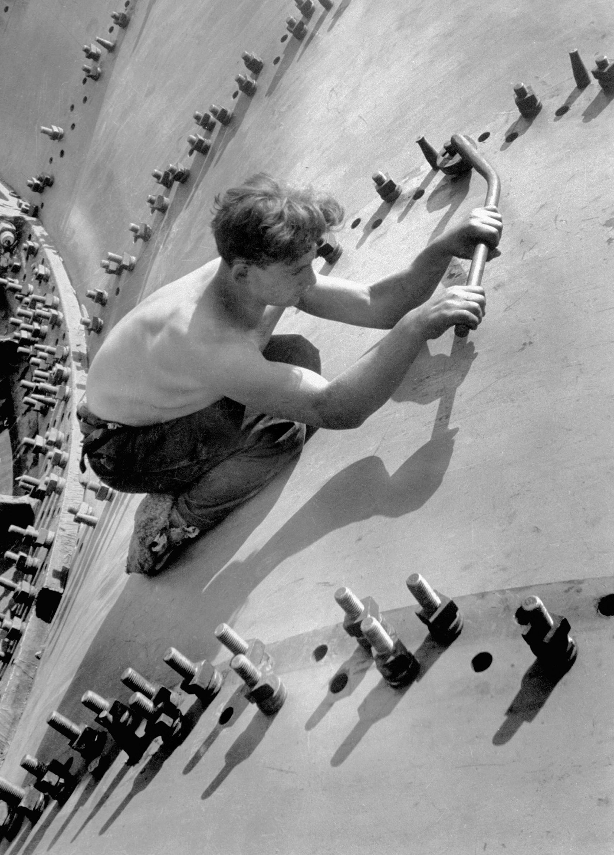
Man tightening the large nuts on the turbine shell of the Dneprostroi Hydroelectric Plant near Zaporizhia, Soviet Union, 1930, Margaret Bourke-White
Stalin’s Mother, 1931, Margaret Bourke-White

Slide 8
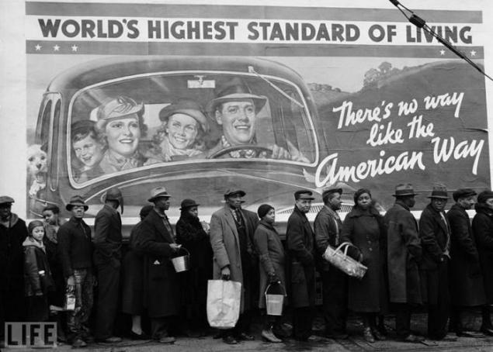
New Deal, Montana: Fort Peck Dam, 1936, Margaret Bourke-White
Lifestyle Citizens of America (The American Way), 1937, Margaret Bourke-White

Slide 9
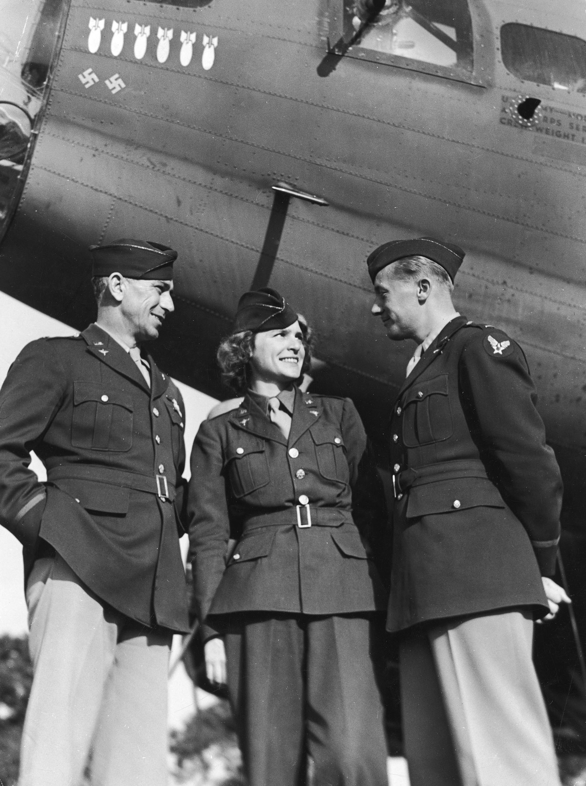
Buchenwald, 1945, Margaret Bourke-White
Margaret with the Army Air Corps, 1945

Slide 10
Indian leader Mohandas Gandhi reading next to a spinning wheel at home. India, 1946, Margaret Bourke-White

Slide 11
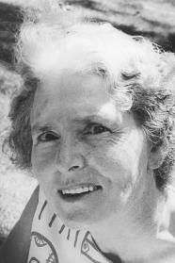
Retirement, Death + Legacy
Diagnosed with Parkinson’s in 1954
Lost ability to photograph in 1957
Died 1971 (Stamford, CT)
Broke so many barriers for women in the field

Slide 12
Publications
Eyes on Russia (1931)
You Have Seen Their Faces (1937; with Erskine Caldwell)
North of the Danube (1939; with Erskine Caldwell)
Shooting the Russian War (1942)
They Called it "Purple Heart Valley" (1944)
Halfway to Freedom: A Report on the New India (1949)
Interview with India (1950)
Portrait of Myself (1963)
Dear Fatherland, Rest Quietly (1946)
The Taste of War (selections from her writings edited by Jonathon Silverman)
Say, Is This the USA? (Republished 1977)
The Photographs of Margaret Bourke-White

Slide 13
Sources
http://www.famousphotographers.net/margaret-bourke-white
https://www.loc.gov/rr/print/coll/womphotoj/bourkewhiteessay.html
http://www.tfaoi.com/aa/5aa/5aa12.htm
http://pictify.saatchigallery.com/732868/the-world-of-old-photography-margaret-bourke-white-law-collage-cornell
http://baumwollarchives.com/tag/cleveland/
http://thestrathallan.com/wp/margaret-bourke-white/?doing_wp_cron=1486019708.4542560577392578125000#1451389555493-84b00abf-5c8b
http://www.iphotocentral.com/common/detail.php/256/Margaret+Bourke-White/0/0/0/14718/1
https://www.icp.org/browse/archive/objects/knife-wielding-butcher-about-to-cut-up-dead-pig-at-swift-meat-packing
http://www.photography-now.com/exhibition/91399
https://bashny.net/t/en/130031
Portrait of Myself by Margaret Bourke-White
Margaret Bourke-White by Vicki Goldberg

