Slide 1
The Conference A summary
SCIENCE – we now know what needs to be done.
ENGINEERING- tomorrow we will hear a menu of options of existing, permitted technologies known to work
Notes:
Gobler has laid the ground work for what needs to be done

Slide 2
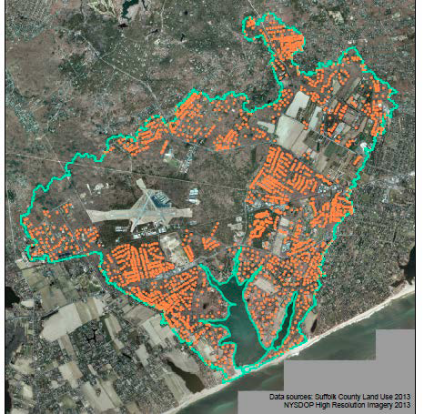

Slide 3
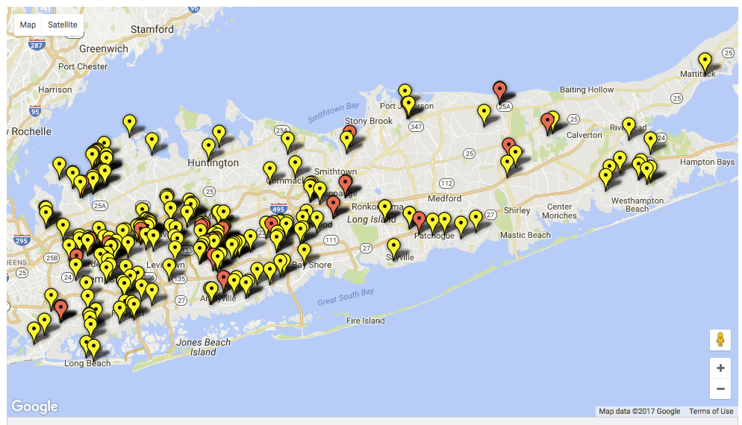
State and Federal Superfund sites
http://data.newsday.com/long-island/data/water/superfund/

Slide 5
Notes:
Private is permitted not actual flow and is therefore overstated

Slide 7
Are we ready for Change?
"Stasis is the norm for complex systems; change, when provoked at all, is usually rapid and episodic".
Stephen Jay Gould

Slide 8
Notes:
A good idea in 1950 when the population was 264000

Slide 10
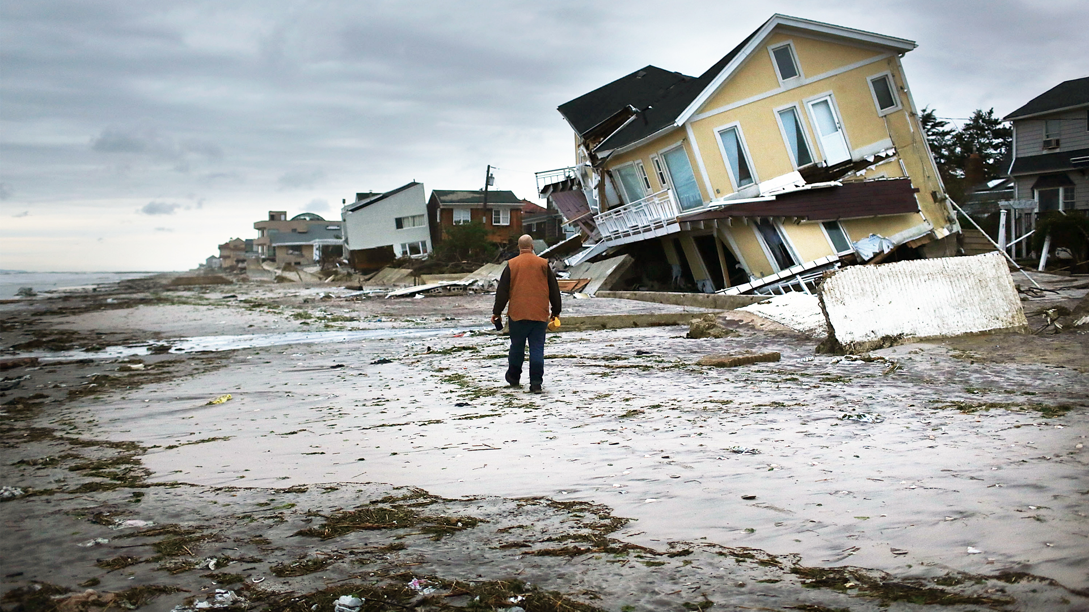
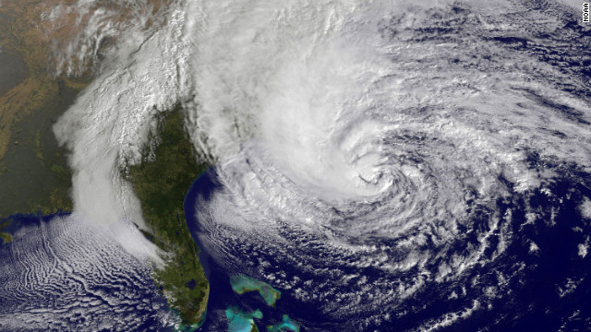
Climate Change
Rising Sea Levels
Storm Surges
Increasing storm intensities

Slide 13
Next Task ?
The emerging action plan for remediating Georgica Pond will be presented as a case study to ignite a broader discussion on holistic approaches to water body remediation. We also hope to draw linkages between thought leaders from top institutions, generating new ideas, approaches, and partnerships that will advance the practice of water body remediation beyond Long Island.

Slide 14
DEMONSTRATION
Design, Permit, Build and Operate
A system capable of Pond remediation.
A system capable of treating wastewater that is contaminating ground water.
A System capable of treating surface run-off
Visitor Center/Interpretative Site
Classroom, videos/incorporation of Gobler’s work; Student interns
On-going testing and research; habitat restoration

Slide 15
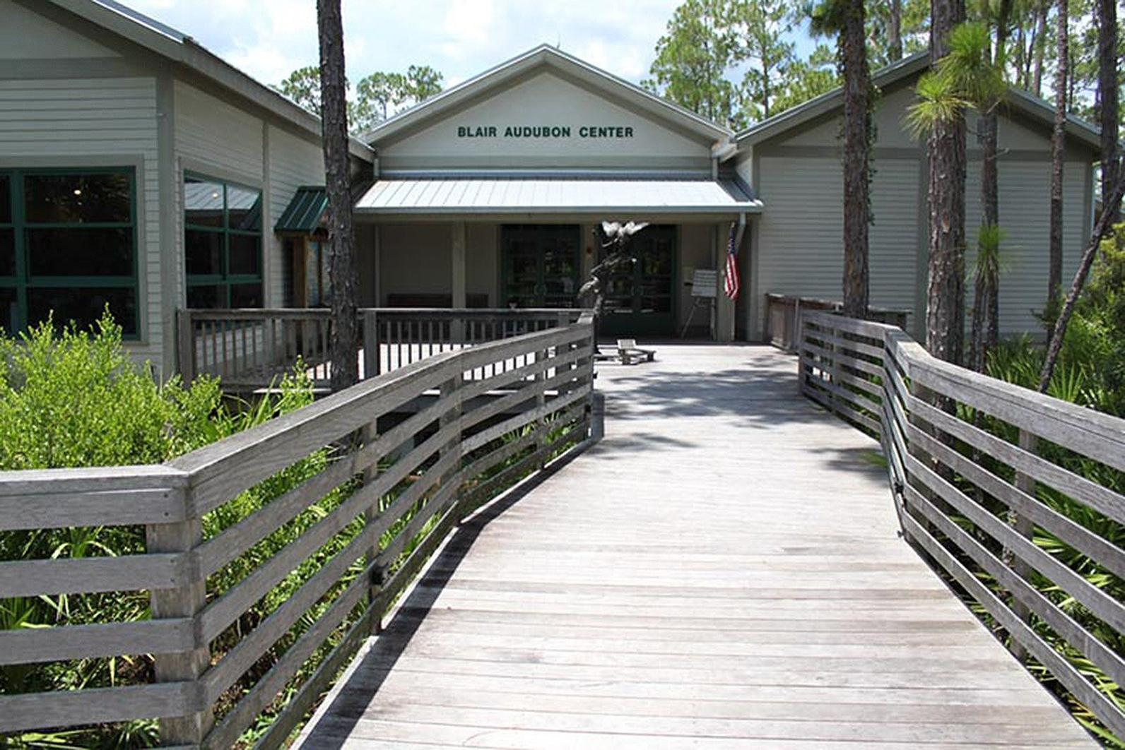
Suffolk County Marine Education Center
Somerset County NJ Environmental Education Center
Audubon

Slide 16
“The definition of insanity is doing the same thing over and over again and expecting different results” A. Einstein
The first rule of change: “get as many people as possible who are committed and are in accord with the general principle which in this case is clean water”
“The world, unfortunately rarely matches our hopes an consistently refuses to behave in a reasonable manner” S. Gould
“Change is more often a rapid transition between stable states than a continuous transformation of slow and steady rates” S Gould

Slide 17
Implementation (in the larger community of Long Island)
Agents of Change – Social scientists, media experts, artists, community leaders, politicians.
requisite diversity, facilitation of initial conditions; free flow of information information =DNA; homeostasis vs homeorhesis rf Wheatley;
Dancing with Systems rf Donella Meadows

Slide 18
Agents of Change -con’t
Catalytic innovators
Film - BBC Planet Earth; Blue Planet
Technology, Social Institutions, Population, Environment

Slide 19
Challenges & Opportunities
The Clean Water Act was passed in 1972. Why are we still arguing over what is clean water?

Slide 20
Regulatory compliance and complications
Complex, time consuming; prescriptive, multiple agencies, expense of retaining qualified reviewers.
NYS DEC -269 pgs of prescriptive regs; out of date because of improved flow; restrictive – if applied to computers we would be using vacuum tubes and rotary dial phones.
Suffolk County – 54 pgs “shall conform to standards herein approved”
Significant Public resistance to regulation & costs!
Some Alternatives
Prescriptive vs performance based regulations
Eco-Districts – water, wastewater, energy, heating, cooling, habitat all under “one roof”.

Slide 21
WQ Standards – what, who and how
Examples:
Drinking water: Hex Cr is 100 ug/L in NY, .02 ug/L in CA
Estuarine Discharge – South Coast CA
Total Phosphorus 0.05 mg/l Stream
Total Phosphorus 0.025 mg/l Standing body of water
Nitrogen N:P = 10:1
Ammonia, Un-ionized 0.025 mg/L
The role of Finance and Commerce
SRF, Bonds, Eco-District, iPhone equivalent? (10 -12% ROI typical
Ethical and Legal issues; do we have a right to pollute?

