Slide 1
Welcome to Georgica Pond
East Hampton, New York
Friends of Georgica Pond Foundation, Inc.

Slide 3
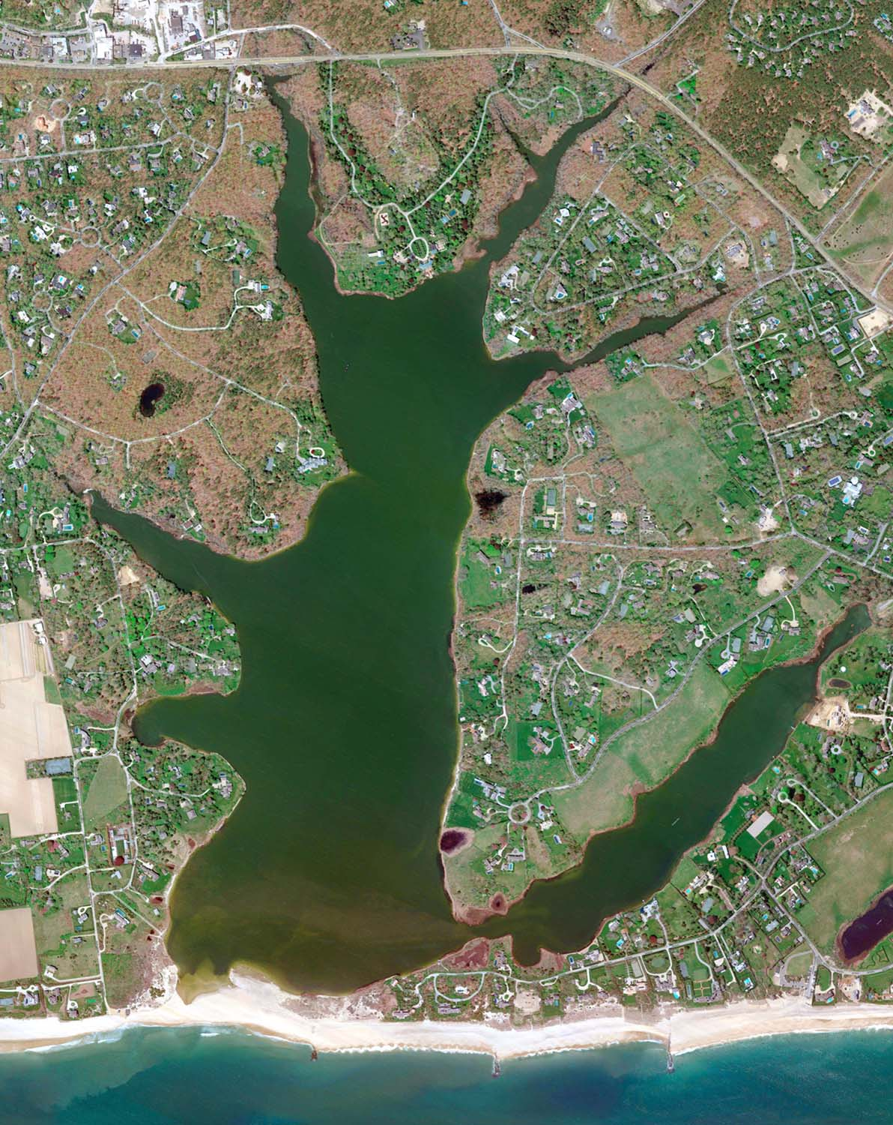

Slide 4
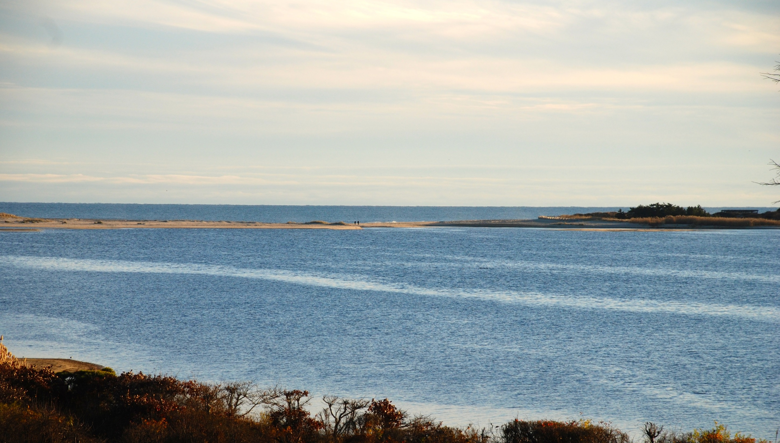

Slide 5
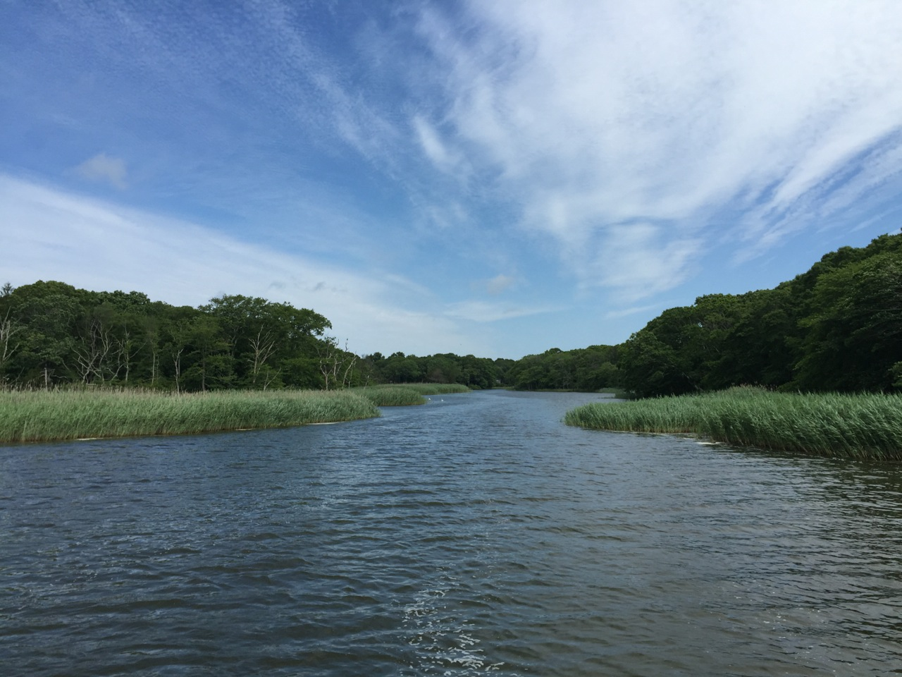

Slide 6
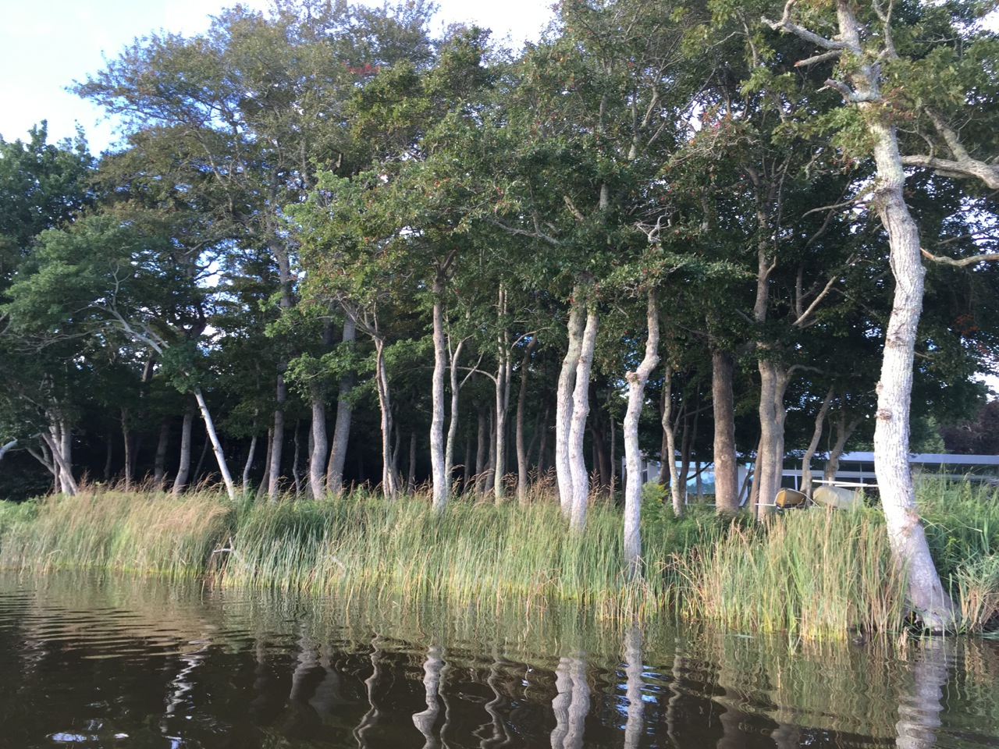

Slide 7
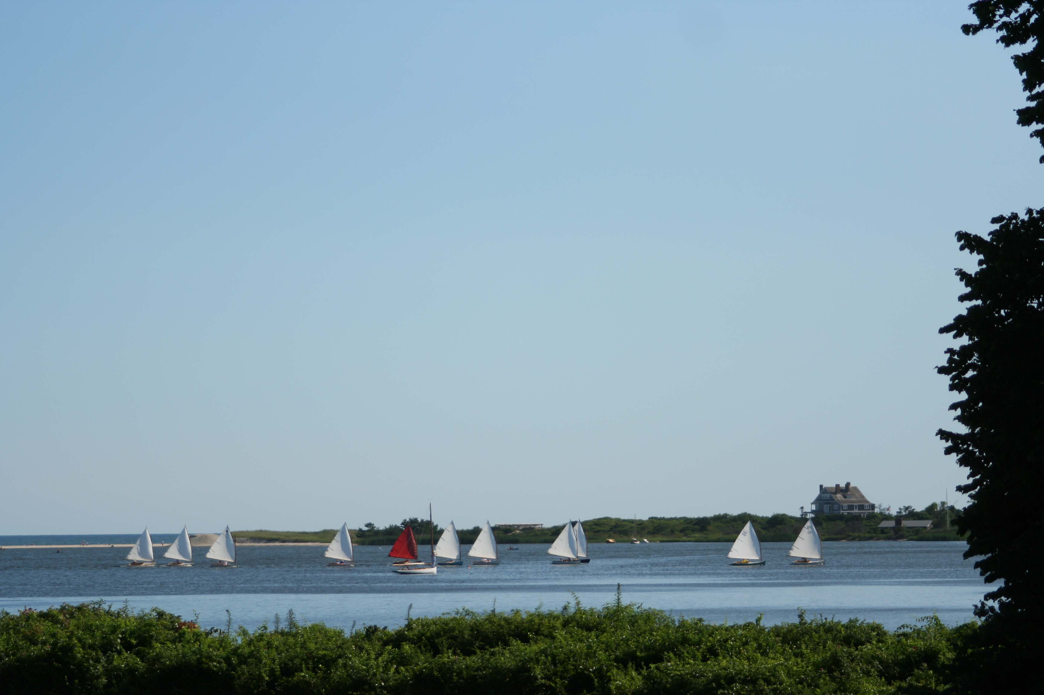

Slide 8
Our Charismatic Species, the Blue Crab

Slide 9
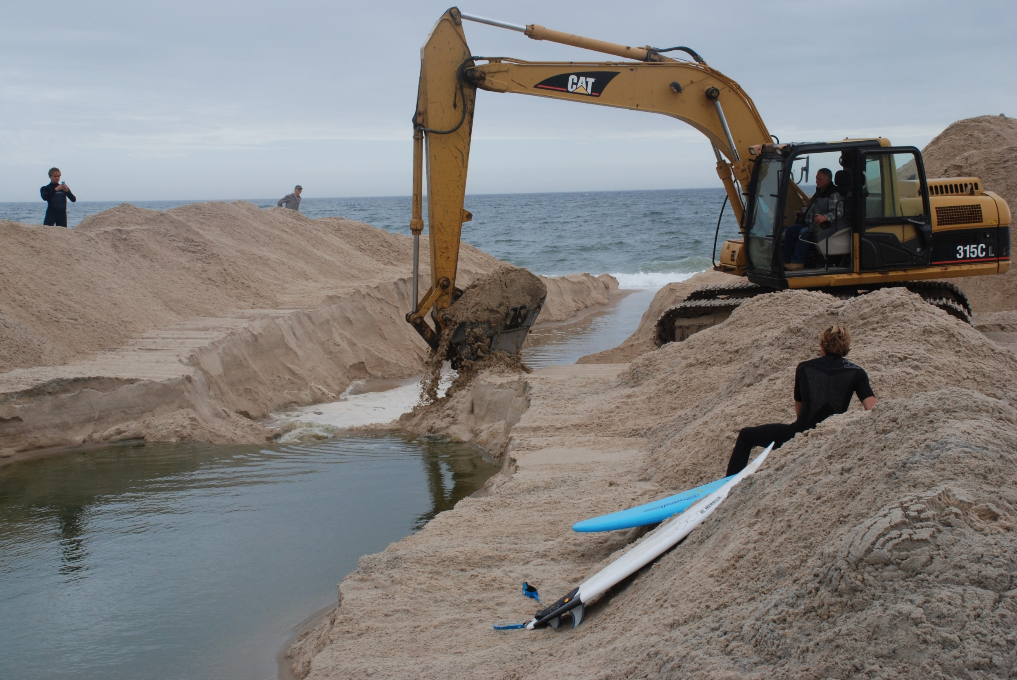

Slide 10
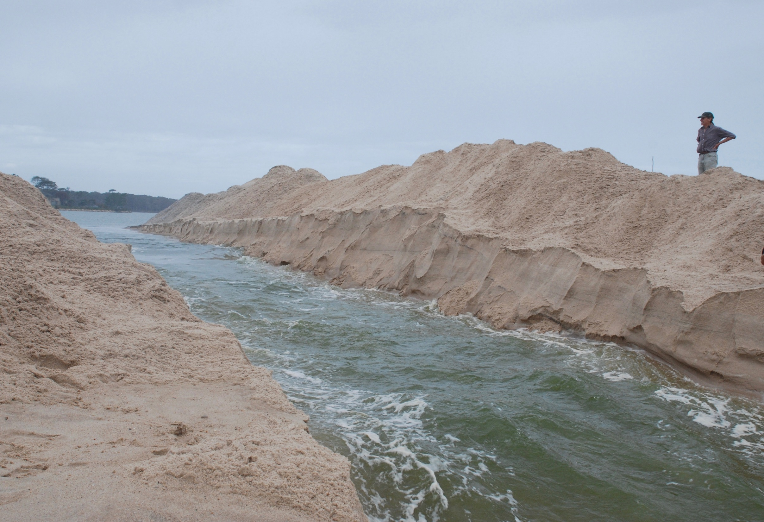

Slide 11
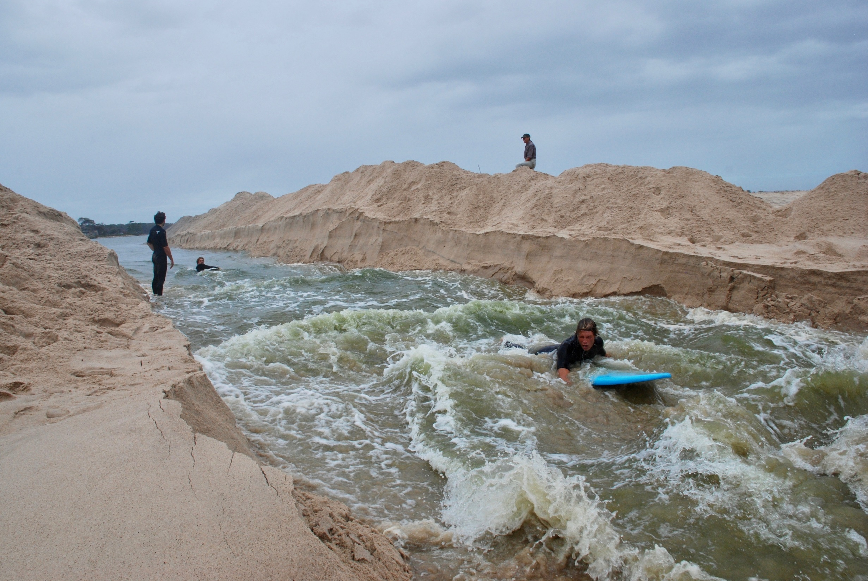

Slide 15
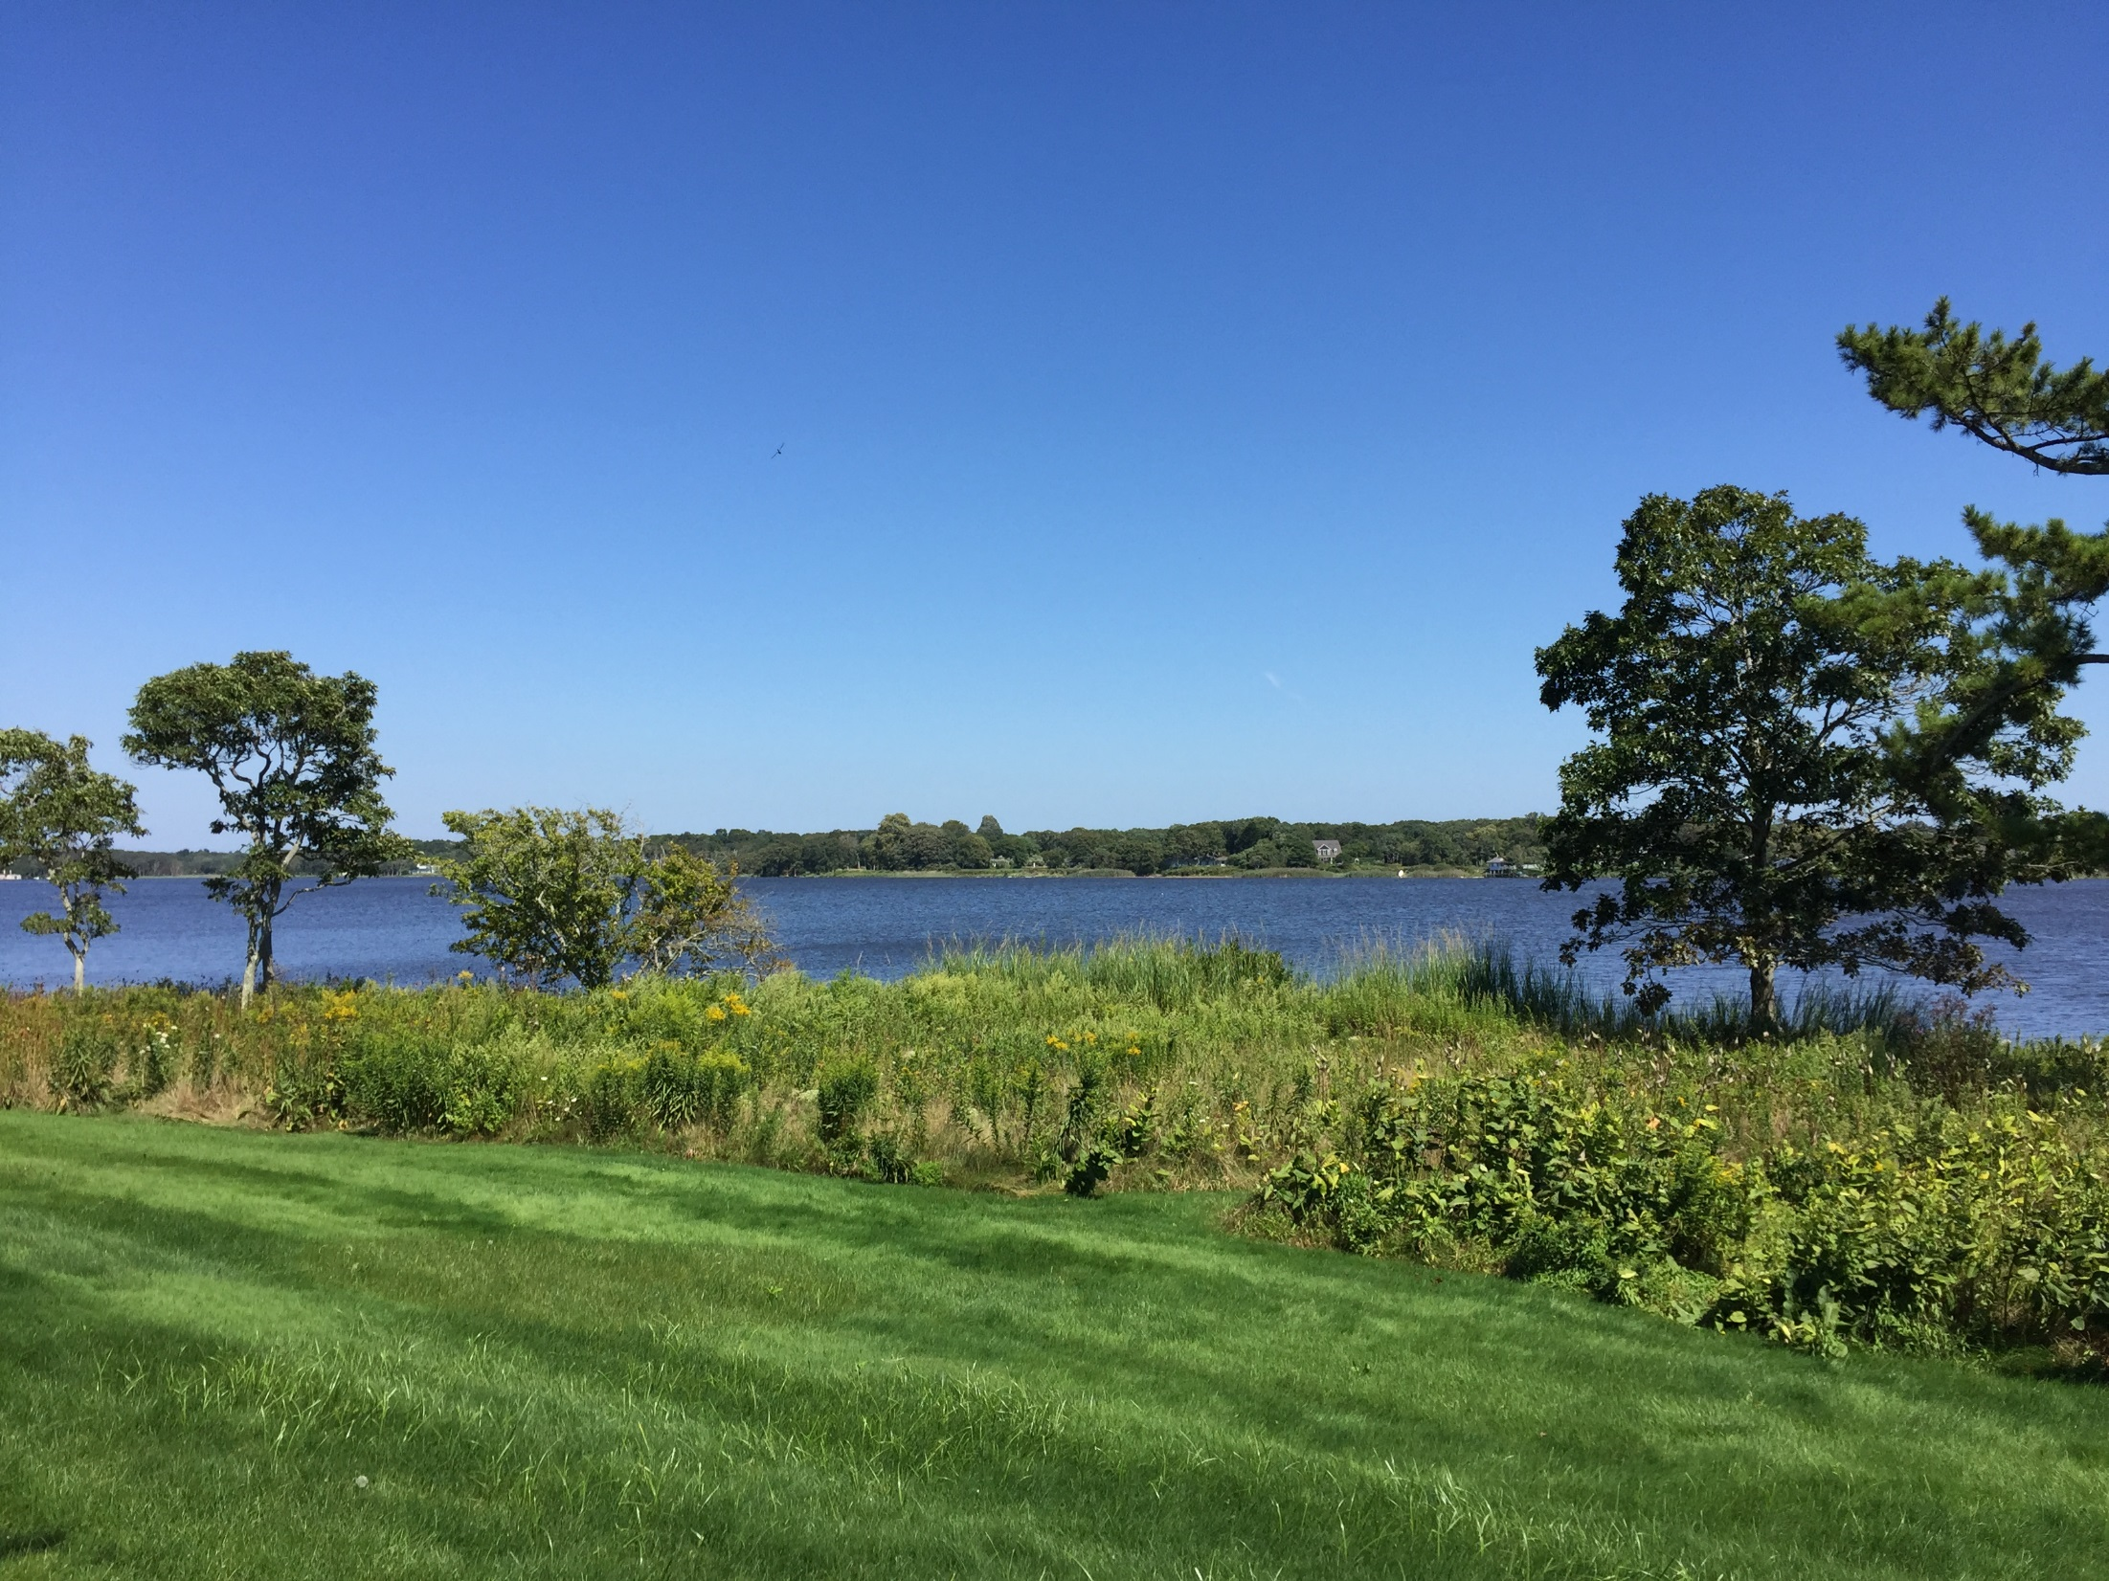

Slide 16
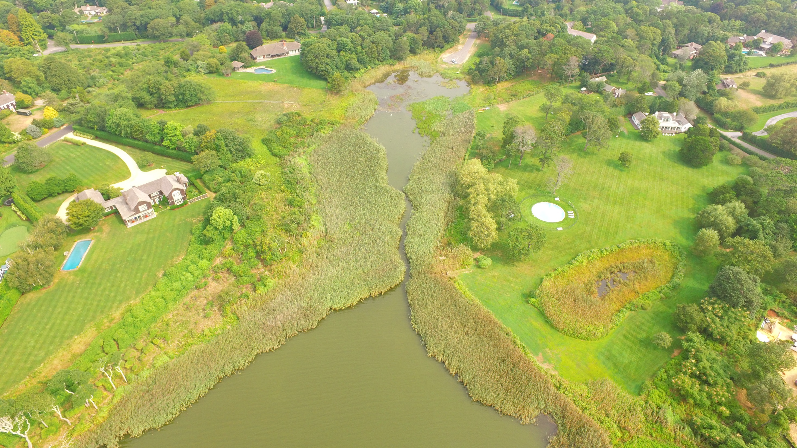

Slide 17
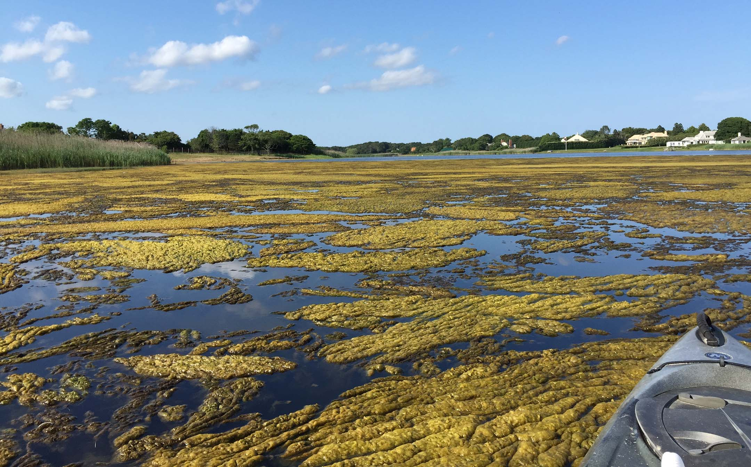

Slide 18
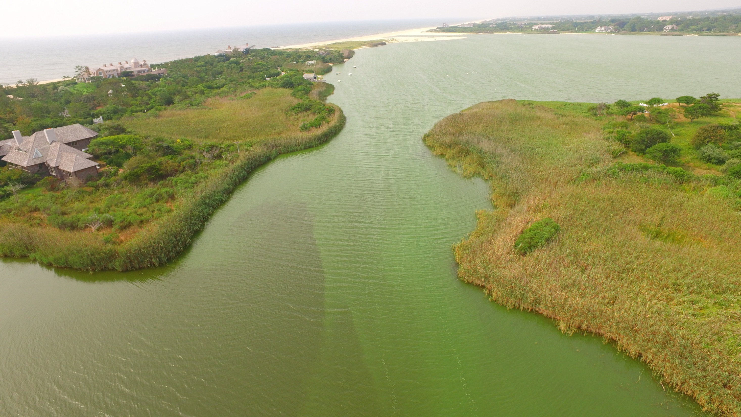

Slide 19
With thanks to: Town of East Hampton, Village of East Hampton, East Hampton Town Trustees, Suffolk County, Dr. Christopher Gobler, The Nature Conservancy, Peconic Land Trust, PRFCT Earth Project, Surfrider Foundation.

