Slide 1
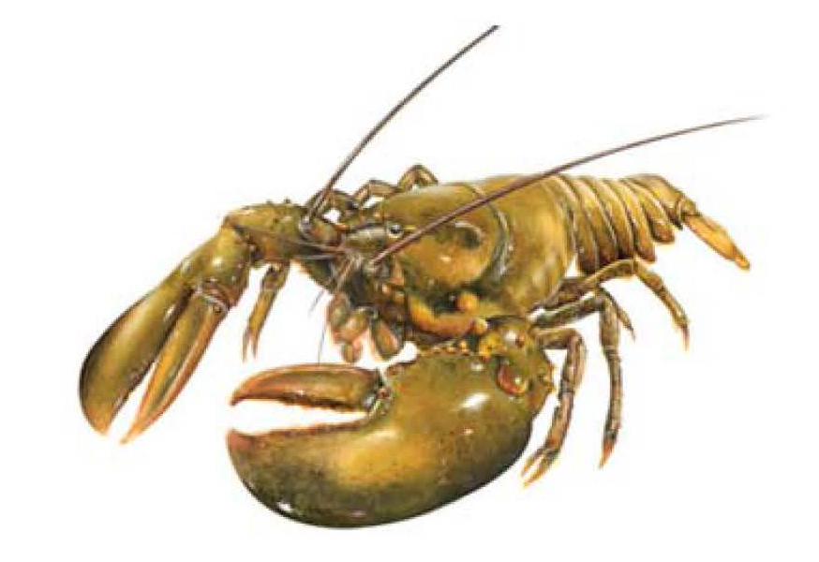
ASMFC American Lobster Draft Addendum XXV
November 15, 2016

Slide 2
SNE Stock Status
SNE lobster Stock is at record low abundance and experiencing recruitment failure (ASMFC, 2015)
Poor condition due to environmental factors and continued fishing mortality

Slide 3
Management Goal
“Recognizing the impact of climate change on the stock, the goal of Addendum XXV is to respond to the decline of the SNE stock and its decline in recruitment while preserving a functional portion of the lobster fishery in this area.”

Slide 4
Initial Management Response
Addendum XXV was initiated to consider increasing egg production in SNE by 20% - 60% to increase chances of good recruitment if environmental conditions become favorable.

Slide 5
Management Tools Considered
Gauge size changes
Trap reductions
Closed seasons
Trip limits
V-notching
culls

Slide 6
Lobster Addendum XXV Timeline
Nov 2016 - Contact LCMT members via mail to see if they recommend additional management tools
Nov 30, 2016 – LCMT suggestions due to ASMFC
Feb 2017 Board meeting – finalize draft Addendum XXV – approve for public comment
Winter 2017 – Addendum XXV Public Hearings

Slide 7
Thank You
Kim McKown
MIPR Unit Leader
Kim.mckown@dec.ny.gov
631-444-0454
Connect with us: Facebook: www.facebook.com/NYSDEC Twitter: twitter.com/NYSDEC Flickr: www.flickr.com/photos/nysdec

