Slide 1
Marine Resource Advisory Council January 15, 2013
An update on the 2013 Summer Flounder, Scup, and Black Sea Bass
recreational fishing regulations

Slide 2
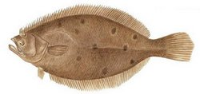
Summer Flounder
2012 Regulations: 4 fish at 19.5” May 1 – September 30
In 2012 NY recreational anglers harvested (MRIP):
514,328 fluke
1.35 million targeted trips
NY’s 2013 allocation = 440,960 fish
Assuming no changes:
recreational summer flounder harvest reduction of 14.3%

Slide 3
Declining Federally Set Harvest Limits
**The Harvest Limit in 2013 is only ~90% of the 2012 limit.**

Slide 4
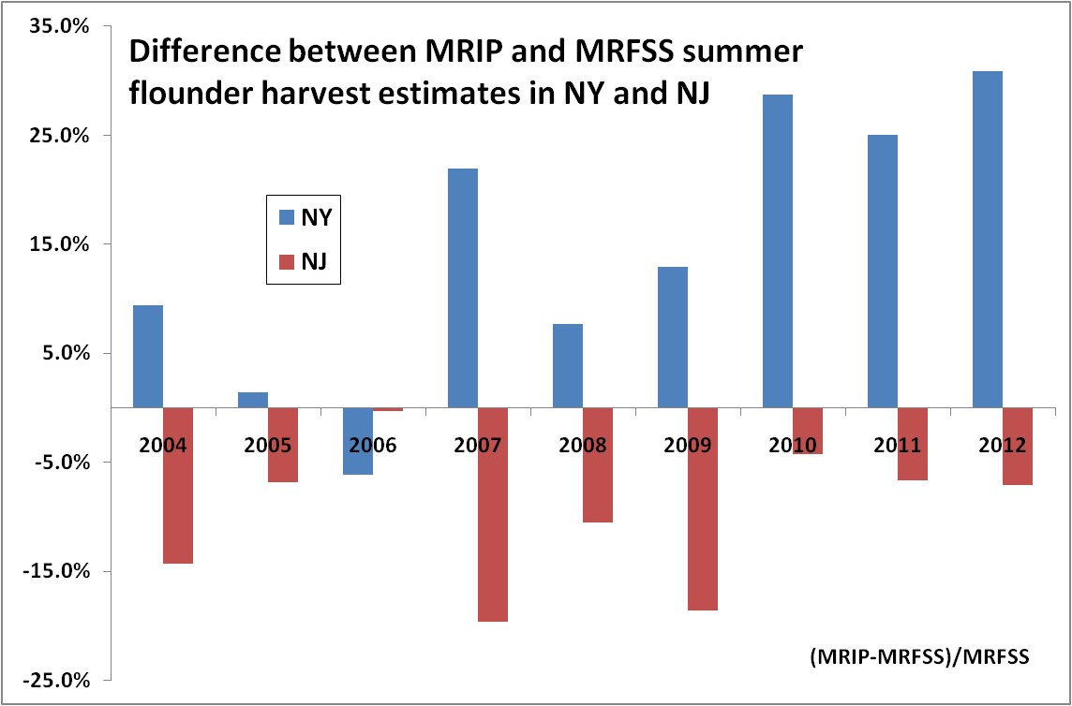
Harvest Estimate Discrepancy
Problem: Allocations are still based upon 1998 MRFSS harvest estimates
NY Avg. = MRIP is 14.6% higher than MRFSS NJ Avg. = MRIP is 9.8% lower than MRFSS

Slide 5
Summer Flounder …to be continued…
Reconsider the 1998 MRFSS based allocation?
Status quo regulations?
Decrease NY’s minimum size?
The next ASMFC meeting is scheduled for February 19-21, 2013.

Slide 6
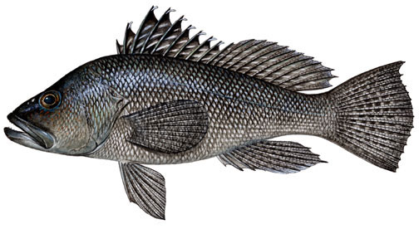
Black Sea Bass
2012 Regulations: 15 fish at 13” June 15 – December 31
In 2012 NY recreational anglers harvested (MRIP):
272,955 black sea bass (through Oct. 31 only)
Nov. and Dec. estimates wont be available until ~Feb. 15
2012 Regional Management:
MA, RI, CT, NY & NJ
Overharvested black sea bass.
2012 Coastwide:
Target = 1.32 million lbs
Harvest = ~3 million lbs

Slide 7
Black Sea Bass : January and February Opening
In June 2012, the Mid-Atlantic Fishery Management Council (MAFMC) voted to open federal waters to recreational harvest in Jan. & Feb. (Wave 1).
In Dec. 2012, the ASMFC voted to open state waters to recreational harvest during Wave 1.
NY followed suit:
Matched federal regulations (15 fish at 12.5”)
Bycatch Issue
Level economic playing field
Problems:
No monitoring (MRIP) during Wave 1 except in NC and FL.
Overharvest of black sea bass in 2012.
Unknown if/how states will have to account for Wave 1 harvest of black sea bass.

Slide 8
Black Sea Bass: reconsidering annual catch limits
The MAFMC’s Scientific and Statistical Committee(SSC):
Black sea bass is a Data-Poor species
Uncertainty= conservative Allowable Biological Catch of 4.5 million pounds.
2013 Recreational harvest limit of 1.85 million lbs.
SSC is reconsidering the ABC they have set:
SSC meets January 23, 2013. Council meets February 12 – 14, 2013.
The Council is reconsidering accountability measures:
Could effect all Council governed recreational fisheries
Outcome:
commercial and recreational catch limits
recreational quota “lb for lb paybacks”
recreational fishing seasons in 2013 & 2014
Currently, paybacks from the 2012 harvest would effectively close the 2014 recreational fishery.

Slide 9
Black Sea Bass: Draft Addendum 23
Harvest reduction and management scenarios in 2013
Management:
Coast-wide measures? 51% reduction
State by state? 20-25% reduction for NY
Regional approach? ~45% reduction MA-NJ
Strict regional approach – all regulations the same
Ad-hoc – as consistent as possible across the region
Using a 2 year or 3 year average?
Time Frame:
1 year (expires after 2013)
2 year (expires after 2014)

Slide 10
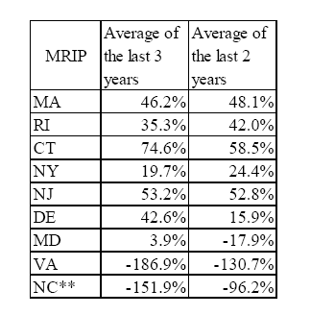
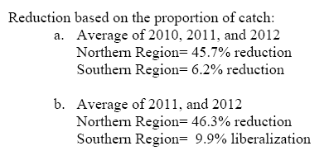
Black Sea Bass: Draft Addendum 23 continued
State by State
Regional

Slide 11
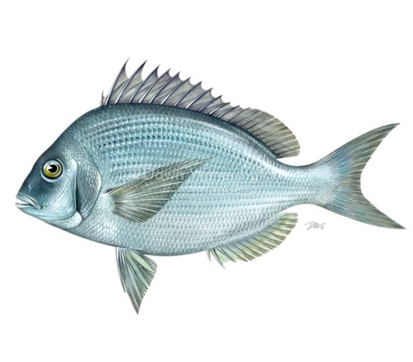
Scup
2012 Private anglers: 20 fish at 10.5” May 1 – Dec. 31
2012 For Hire: 20 fish at 11” May 1-Dec. 31 except Sept. 1 – Oct. 31 when its 40 fish
In 2012, 4 state northern region (MA-NY):
97% of the coast-wide recreational harvest
NY harvested 533,282 fish through Oct. 31
2012 Projected regional harvest:
~3.37 million fish of its 6.95 million target in 2012
The 2013 target is 6.8 million fish:
regulations will be liberalized in a regional manner
Proposed 2013 Federal Regulations:
30 fish at 10”, Open season year around

