Slide 1
2018 Commercial Quota Distribution
Emerging Issues for the Marine Resources Advisory Council
March 6, 2018

Slide 2
Attendees by Gear Type
GEAR | 11/28 | 12/19
HOOK AND LINE | 12 | 13
TRAWL | 13 | 23
POT/TRAP | 9 | 3
GILLNET | 2 | 1

Slide 3
DEC Marine Resources requesting MRAC Feedback on Fluke and Black Sea Bass
Scup and Bluefish – relatively non-controversial
Gear Type
Geography
Vessel size
State vs. Federal Permits
Full vs. Part-time fishery participation

Slide 4
Black Sea Bass (15% Reduction in 2018)
Period 2 opening day in 2017 was May 15.
Interest in earlier opening dates: May 1 or May 7.
Earlier opening will result in earlier closure

Slide 5
Black Sea Bass (15% Reduction in 2018)
Combine periods 2 and 3 (5/15-8/31) or keep separate:
Period 2 (5/15-6/30) and Period 3 (7/1 – 8/3)
Combining likely to result in early summer closure
Keeping separate likely to result in closure in June, a reopening July 1 and another closure in August lasting until September 1
Combining periods may favor some gear types over others.

Slide 6
Summer Flounder( ~14% Increase in 2018)
42,924 lb. overage can be paid back in 2018 but must be paid back by 2019.
Take it from “winter fisheries” where the overage occurred (Dec. and Jan.-April)
Spread it out across 2018, in response to past winter lost overages in other periods.
Mixed Model: Spread payback out amongst all periods with overages by pound.
2018 landings for period 1 are 60,845 as of March 6, 2018.

Slide 7
2017 Quota Overage Summary
Fluke | Quota | Landings | % of quota | Balance
Period 1 January - March | 108,191 | 98,153 | 91% | 10,000
Period 2 April | 43,276 | 17,507 | 40% | 25,769
Period 3 May | 60,586 | 85,315 | 141% | (24,729)
Period 4 June - July | 116,848 | 127,706 | 109% | (10,858)
Period 5 August - September | 60,587 | 62,975 | 104% | (2,388)
Period 6 October | 21,638 | 24,243 | 112% | (2,605)
Period 7 December | 21,638 | 59,806 | 276% | (38,618)
Quota | 432,764 | 475,705 | 109.9% | (42,941)

Slide 8
November Opening?
November closed by design in 2017 due to small quota.
Interest in opening in early November, one week at 50 lbs.
Would require 10,000 lbs. set aside. Rollover would be added to December.
Fluke already has a 42,941 overage.

Slide 9
Weekly summer trip limits only for trawlers participating in the winter weekly program
Limited number of fishers: large vessels, federally permitted.
Multi-day trips only (72 hours +), do not land 50 lbs. daily in NY.
Suggestion was 150 lbs., once per week.

Slide 10
Weekend Closure?
Trial suggested for 2018 Period 5, (August – September, 14% of Quota) to extend the time the period remains open.
Used in Rhode Island.
Likely to impact part- time, commercial fishers with weekday jobs and those that rely upon weekend help.
May see more loss of fishing days due to weather.

Slide 11
Questions?
Other issues of concern?

Slide 12
Fisheries Regulatory Update
Tautog (Recreational and Commercial)
Scup (Recreational only)
Black Sea Bass (Recreational only)
Summer Flounder (Recreational only)

Slide 13
Tautog
Rulemaking package in Albany for legal review
LIS Region
Recreational: 16” min. size, April 1-30 2 fish, Oct 11-Dec 9 3 fish
Commercial: 15” min. size, 25 fish (10 w/ >6 lobsters), May 7-Nov 23 with an August closure
NY Bight Region
Recreational: 16” min. size, April 1-30 2 fish, Oct 15-Dec 22 4 fish
Commercial: 15” min. size, 25 fish (10 w/ >6 lobsters), April 16-Jan 25

Slide 14
Tautog continued
LIS Commercial Tautog fishermen continue to be unhappy with the proposed season (May 7-Nov 23 with an August closure).
East End w/ the loss of days in Nov and Dec
West End pot fishermen with the 1 month closure
Need to maintain/tend gear
Enforcement issues?
Price of fish
Consider revisiting this season prior to the 2019 fishing year

Slide 15
Scup and Black Sea Bass
ASMFC approved 9” minimum size for scup in MA-NY
NY expects to move forward with proposing 9” for all marine recreational anglers
ASMFC approved Addendum XXX for black sea bass in February
Vote didn’t go in favor of MA-NY
Current allocation requires an 11.7% reduction in MA-NY
TC and Board are scheduled to approve methodologies and proposals by March 20
Public meeting to follow

Slide 16
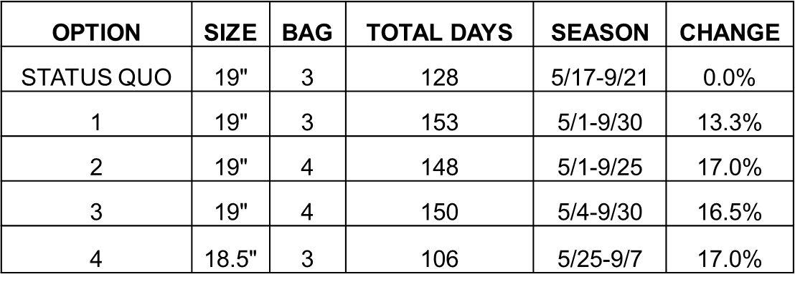
Fluke
Up to a 17% liberalization
NY still has to reach an agreement w/ CT

Slide 17
Fluke continued

Slide 18
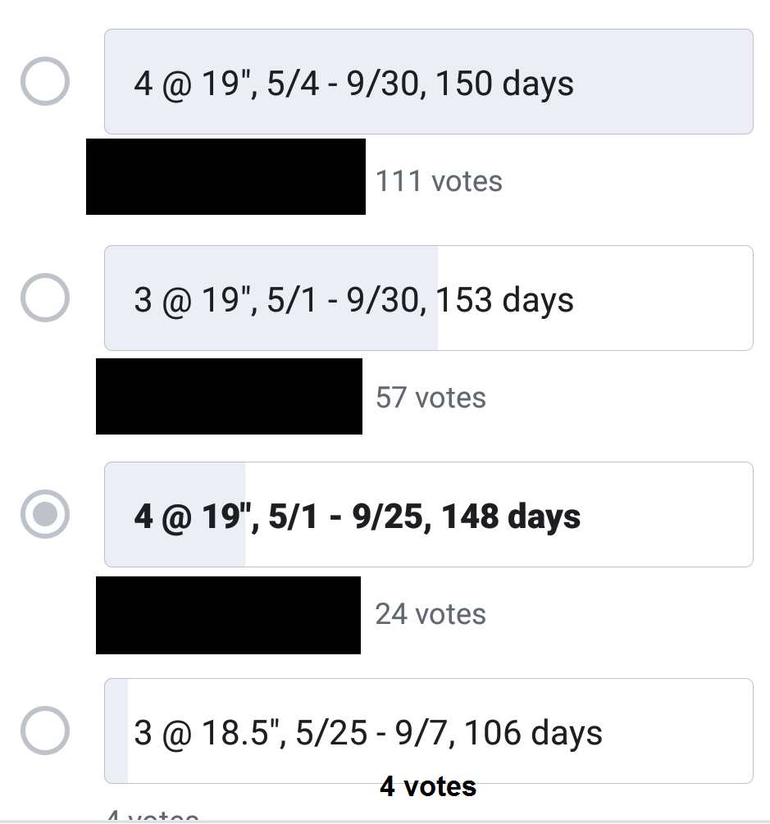
Fluke continued

Slide 19
Fluke
Up to a 17% liberalization
NY still has to reach an agreement w/ CT

