Slide 1
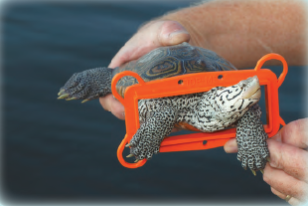
Terrapin Excluder Device
May 8, 2018
MDDNR Publication #03-1282009-430

Slide 2
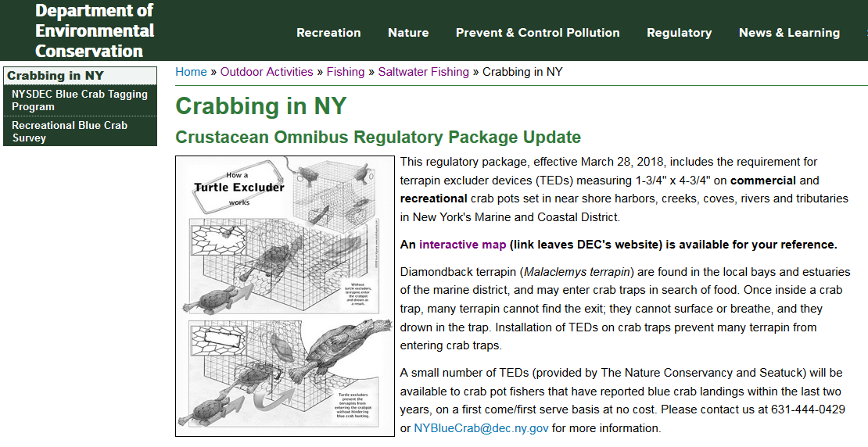

Slide 3
TED Poster
Available from Department
Electronic
Poster copy
Display at shops which sell non-collapsible crab pots

Slide 5
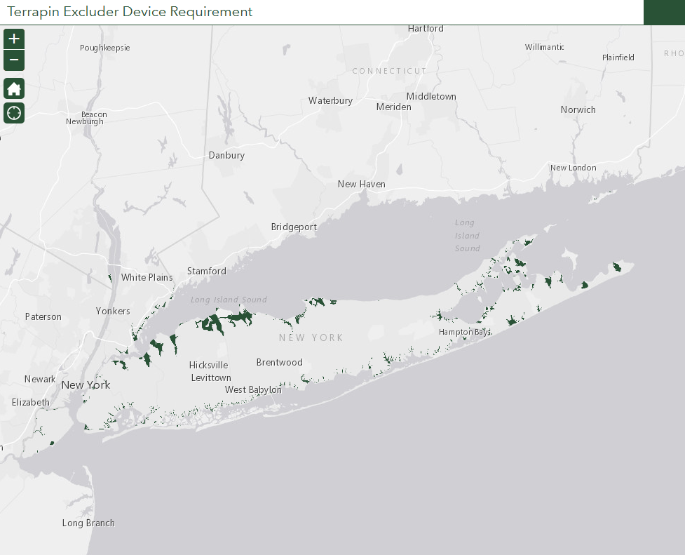
Interactive Map
Click on area to get more detailed view of areas where TEDs are mandated

Slide 6
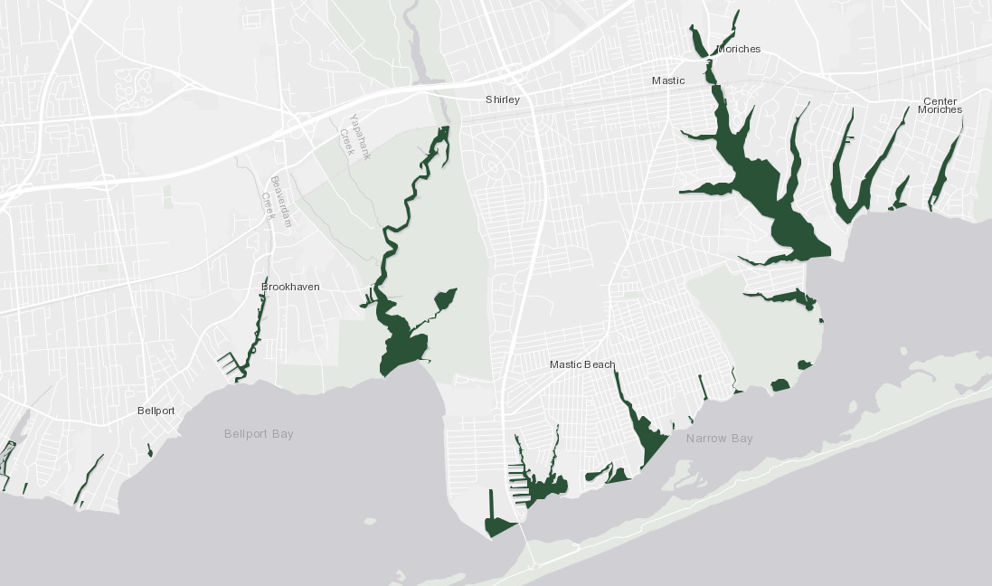
Interactive Map
Click on area to get more detailed view of areas where TEDs are mandated

Slide 7
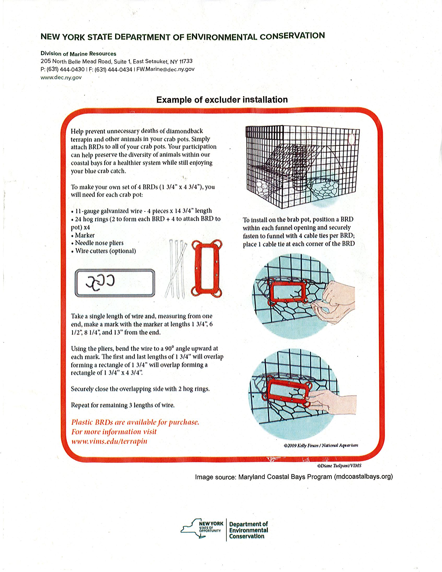
TED Availability
TNC & Seatuck donated 7,000 TEDs (mixture of plastic and wire)
Make your own
Maryland Coastal Bays Program (mdcoastalbays.org)

Slide 8
Thank You
Kim McKown
MIPR Unit Leader
205 N Belle Mead Rd, East Setauket, NY 11733
kim.mckown@dec.ny.gov
631-444-4054
Connect with us: Facebook: www.facebook.com/NYSDEC Twitter: twitter.com/NYSDEC Flickr: www.flickr.com/photos/nysdec

