Slide 1
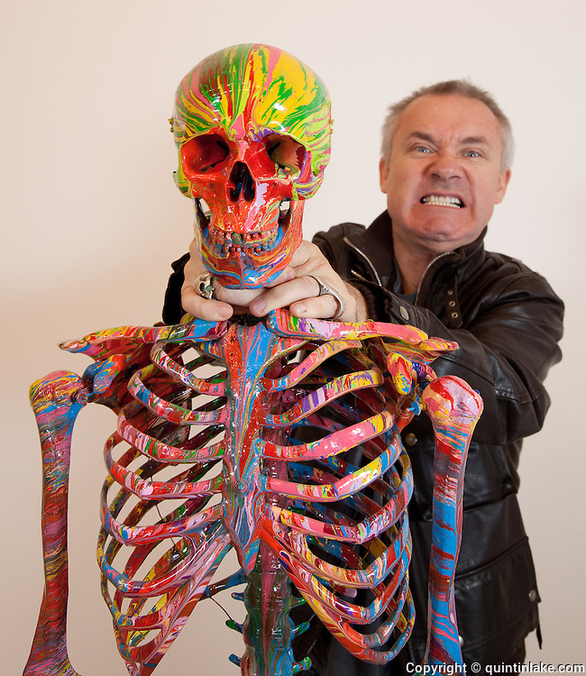
Damien Hirst
Born: June 7, 1965.
British artist, entrepreneur, and art collector.
Installation art, Painting, Sculpture.

Slide 2
Biopsy Paintings

Slide 3
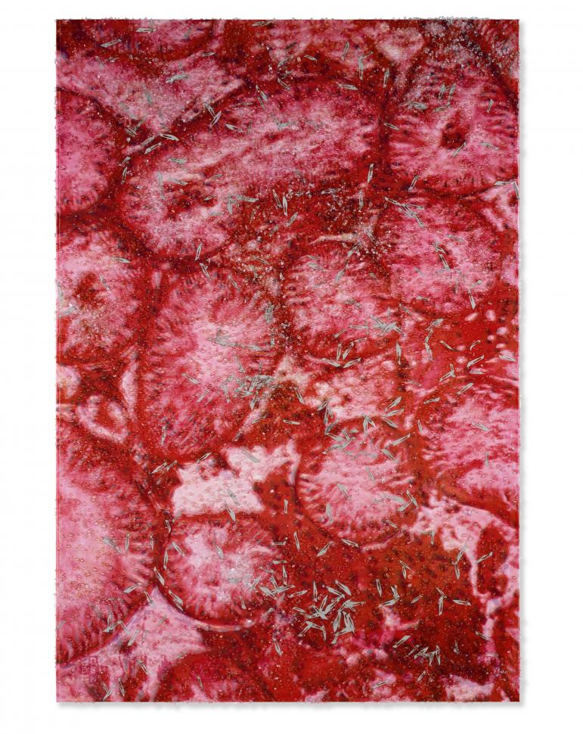
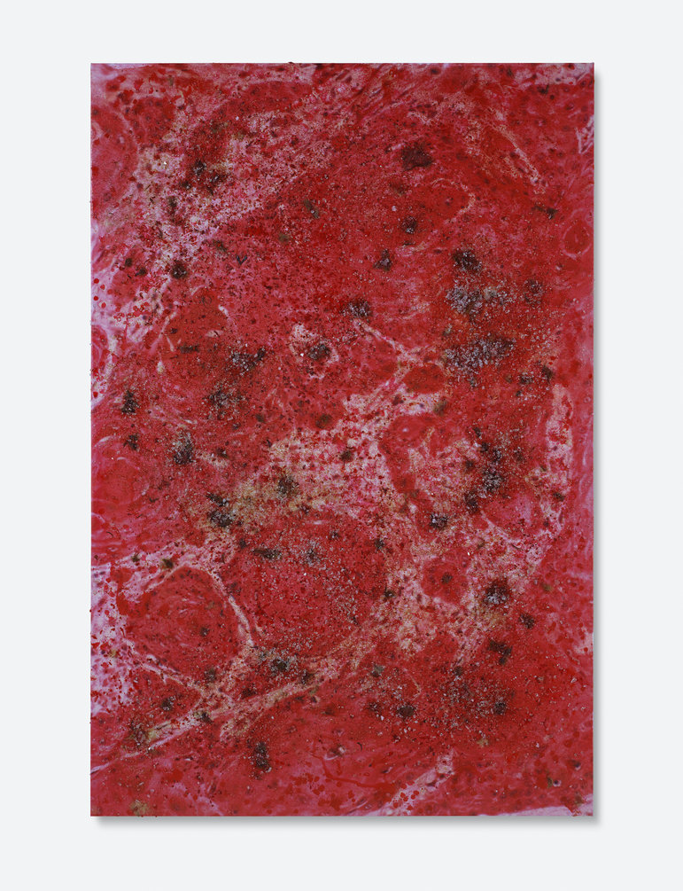
<Male infertility>, 2007, 72in x 48 in, Inkjet print and household gloss on linen with glass and blades
<Skin Cancer>, 2006, 90in x 60 in, Inkjet print and household gloss on linen with glass and hair

Slide 4
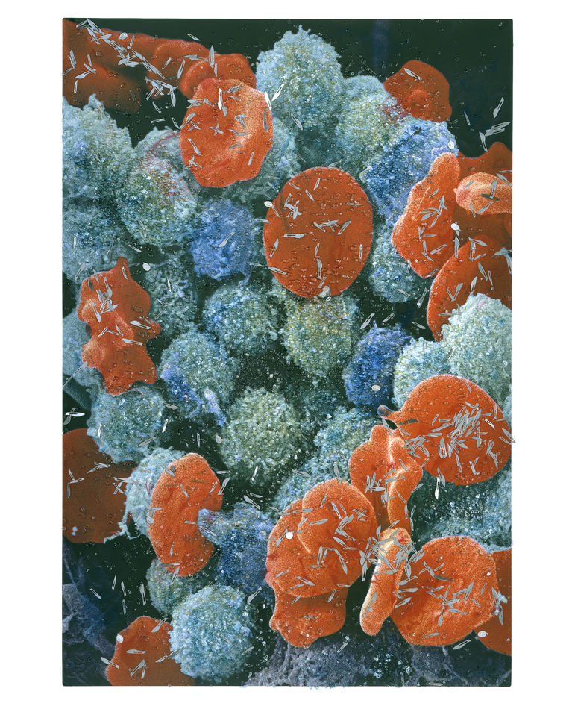
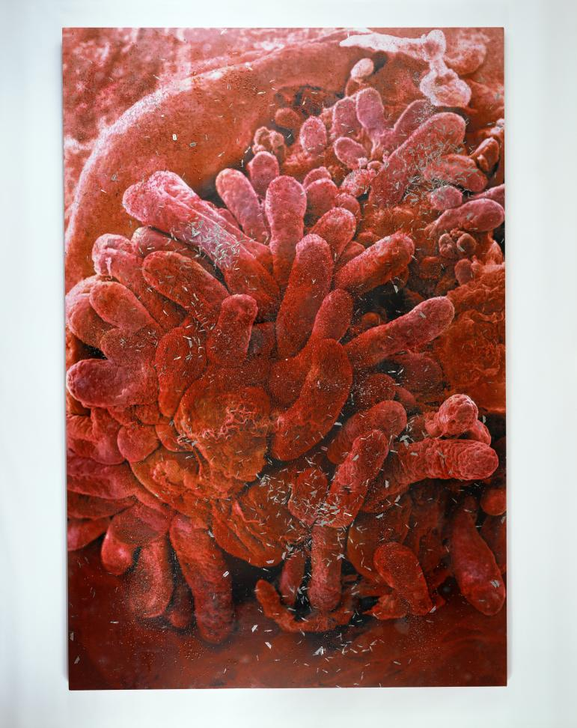
<Leukaemia Blood Cells>, 2008, 72in x 48 in, Inkjet print and household gloss on canvas with glass and religious artefacts
<Small Intestine>, 2007, 180 in x 120 in, Inkjet print and household gloss on canvas with glass and blades

Slide 5
Butterfly Color Paintings

Slide 6
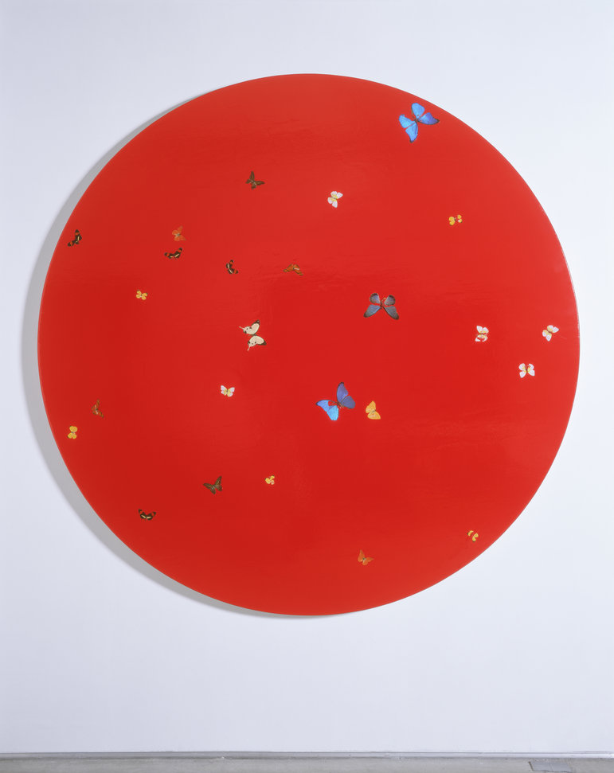
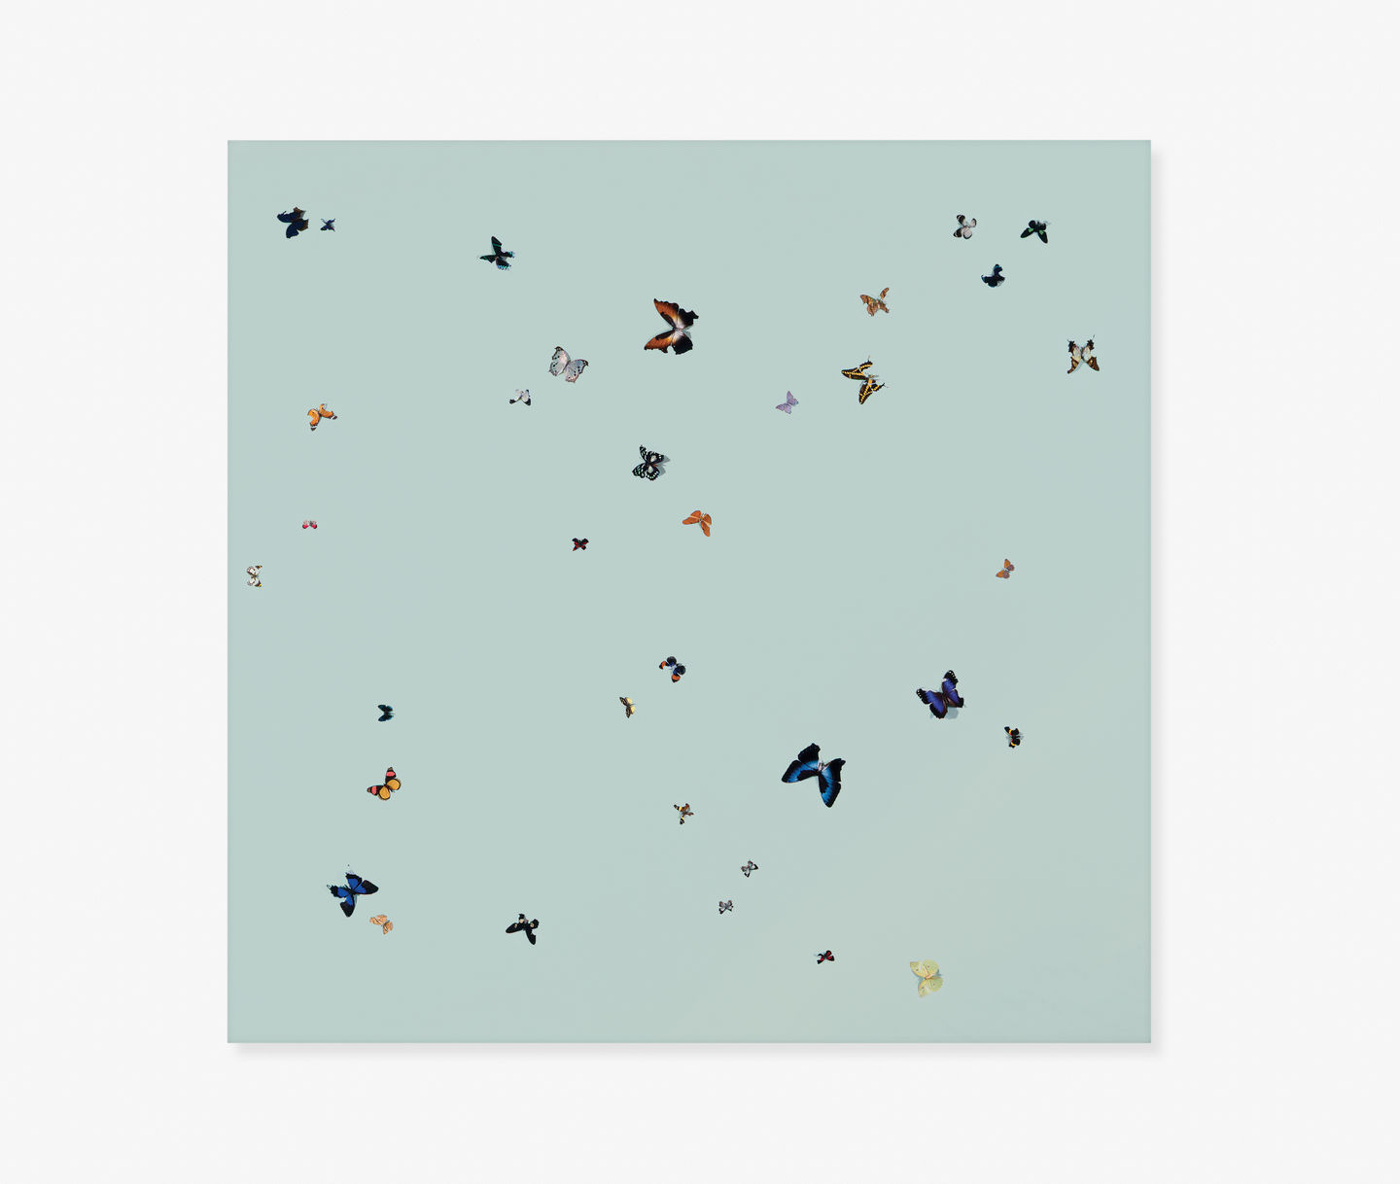
<She loves you>, 1997, 84in, Butterflies and household gloss on canvas
<I feel love>, 1994-1995, 84in x 84in, Butterflies and household gloss on canvas

Slide 7
Spot Paintings

Slide 8
<Spot painting>, 1986, 96in x 144in, household gloss on board

Slide 9
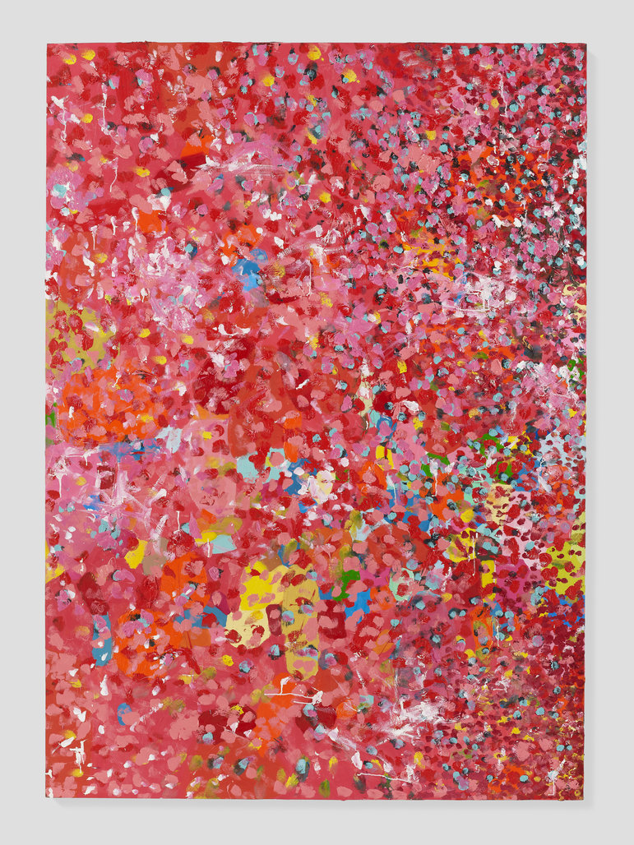
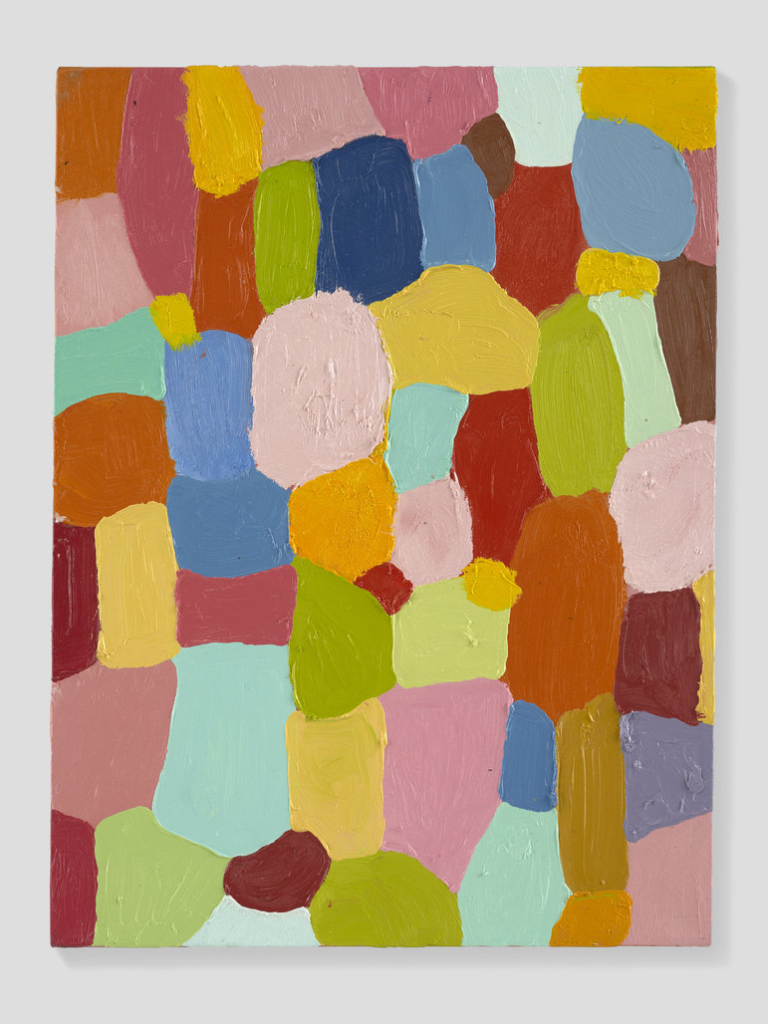
<Happy Fat Daddy Dappy>, 1993, 72in x 60in, oil on canvas
<Happiness>, 1993-1994, 24in x 28in, oil on canvas

Slide 10
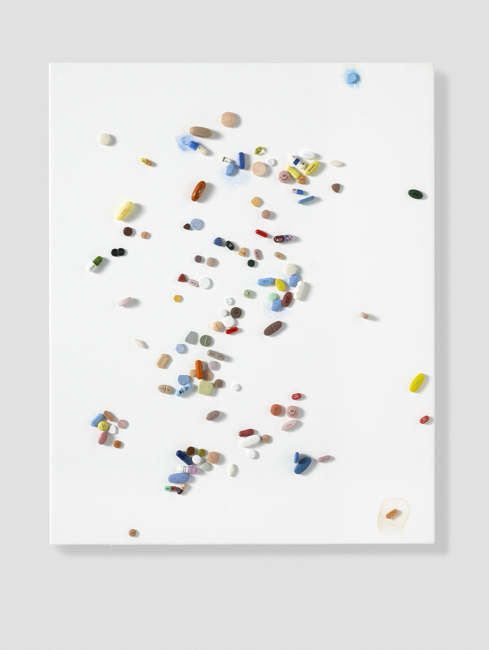
<The Eternal>, 2008-2009, 20in x 16in, Metal, resin and plaster pills and watercolor on canvas
<Morphine Sulphate>, 1993, 57in x 87in, household gloss on canvas

Slide 11
Formaldehyde

Slide 12
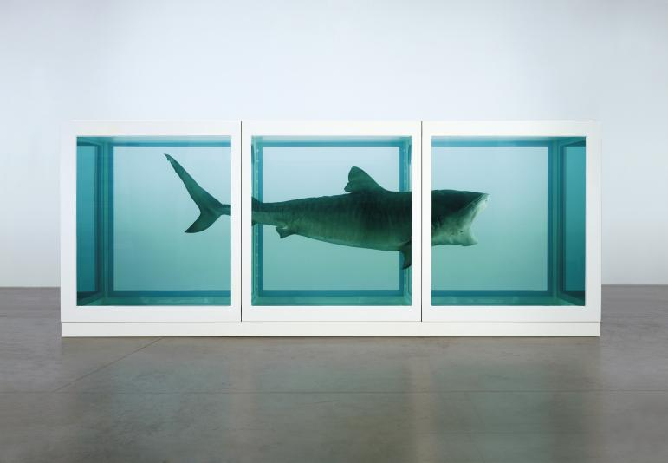
<The Physical Impossibility of Death in the Mind of Someone Living>, 1991, 85in x 213in x 71in, glass, painted steel, silicone, monofilament, shark and formaldehyde solution

Slide 13
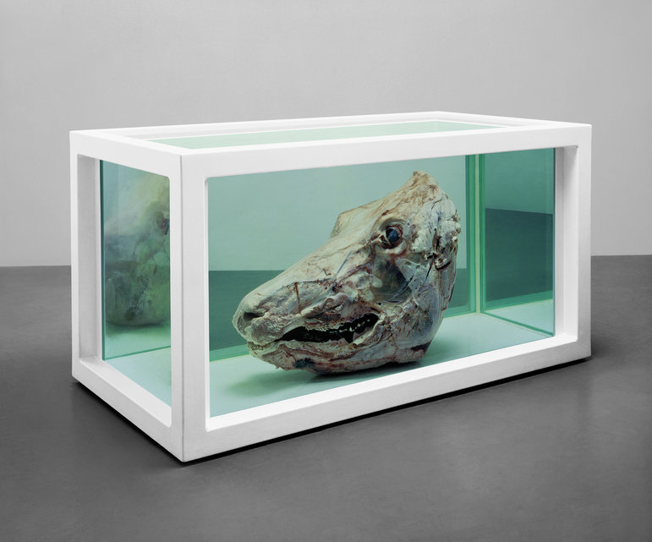
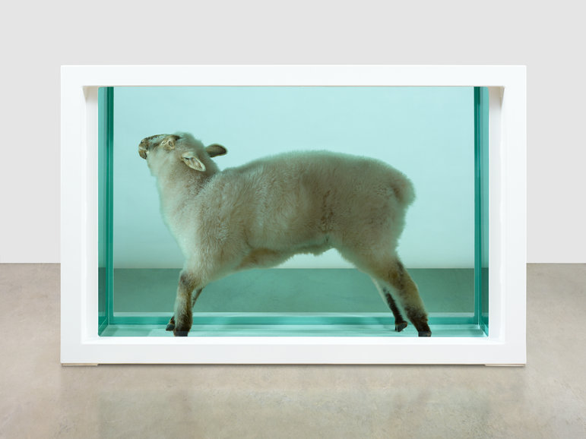
<Away from the Flock)>, 1994, 38in x 59in x 20in, glass, painted steel, silicone, plastic, acrylic, lamb and formaldehyde solution
<Philip(The Twelve Disciples)>, 1994, 18in x 36in x 18in, glass, painted steel, silicone, bull’s head and formaldehyde solution

Slide 14
Cabinet

Slide 15
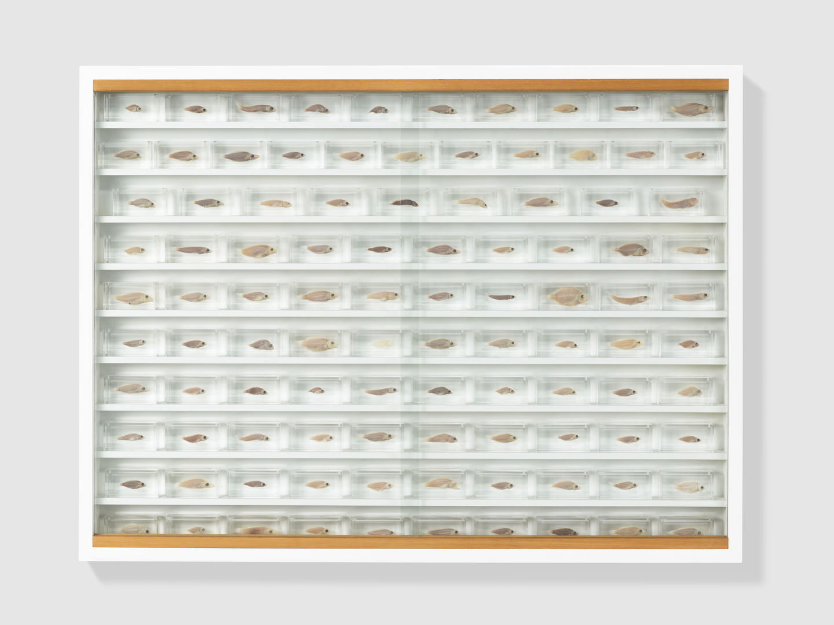
<Alone Yet Together>, 1993, 36in x 48in x 4in, glass, painted MDF, ramin, acrylic, fish and formaldehyde solution

Slide 16
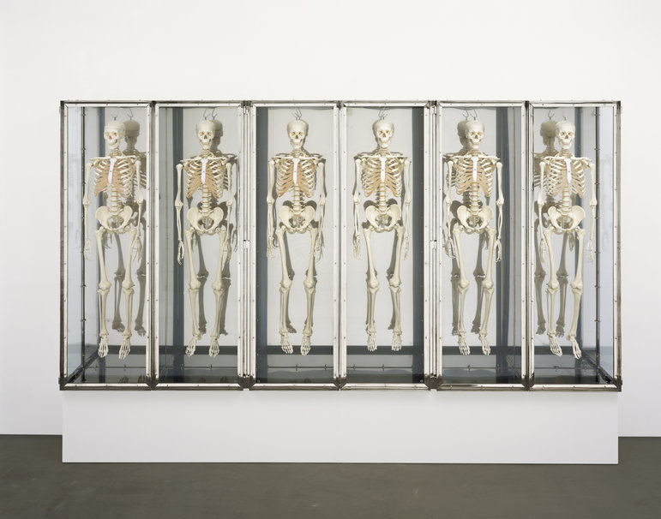
<Yes, But How Do You Really Feel?>, 1996, 78in x 168in x 18in, glass, stainless steel, steel, nickel, brass, rubber and plastic skeletons

Slide 17
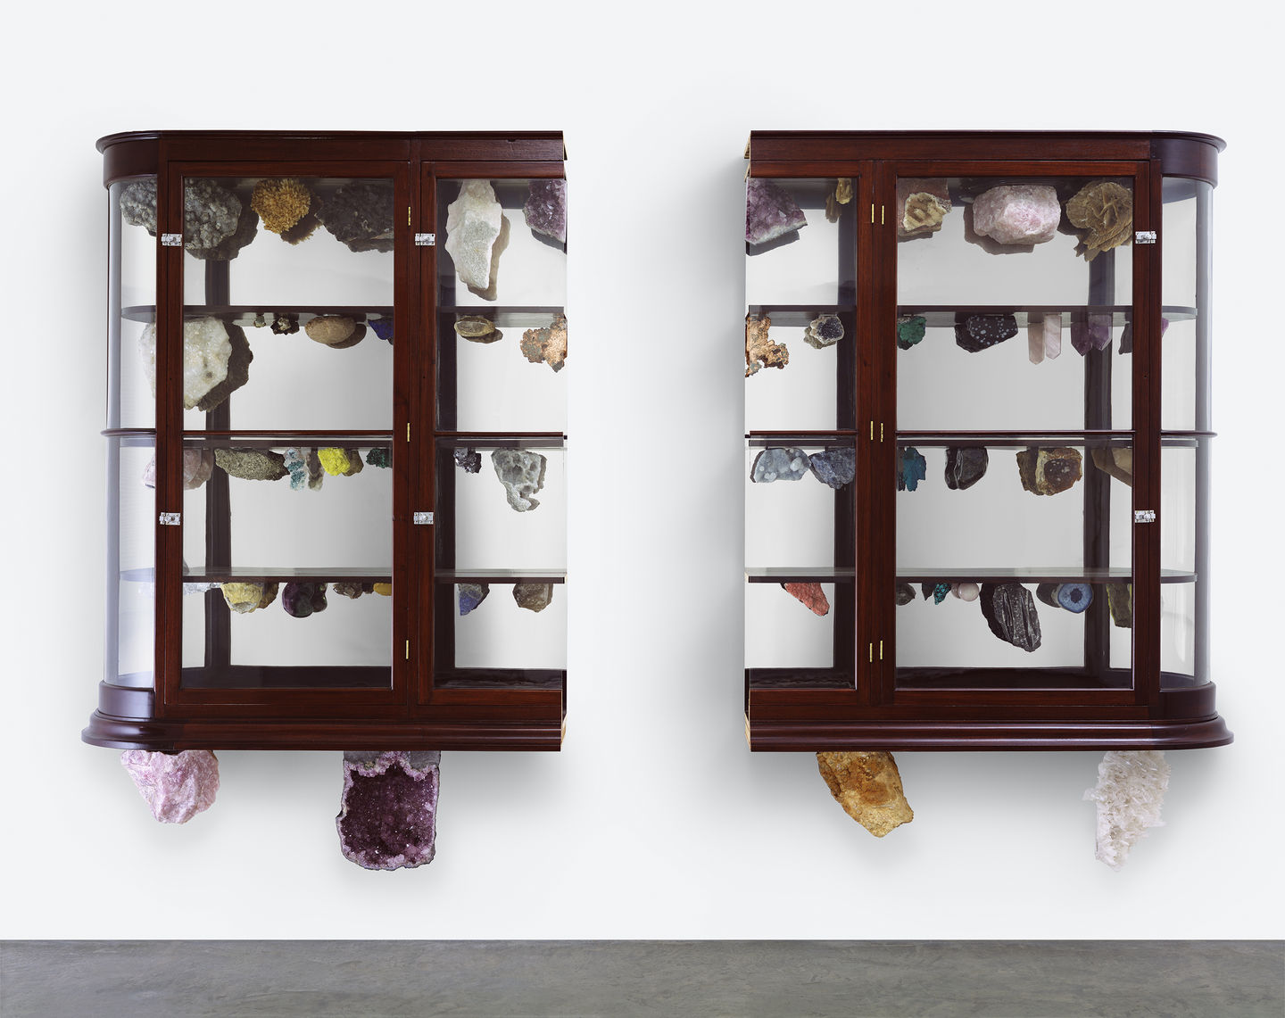
<Creation Explore, Explained and Exploded>, 2003, 67in x 110in x 13in, glass, wooden cabinet, rocks and minerals.

Slide 18
Thank You~

